Slide 1
Notes:
Purpose of this presentation: Describe the capabilities and value of Power BI (the Service, Power BI Desktop and the Platform)
Target audience: Power BI Technical Decision Makers - inclusive of BI Analysts and BI-focused IT Professionals

Slide 2
(HIDDEN SLIDE: PLEASE DO NOT SHOW) Power BI Capabilities deck
Title:
Power BI product capabilities level 200 deck
Length and version:
45 minutes
Content level:
Level 200 for TSPs to present to the customers/partners
Deck contacts:
C+E Data platform marketing (email: sanjay.soni@microsoft.com)
Usage Guide:
This is a level 200 deck that outlines the Power BI capabilities. It is a more detailed deck that accompanies the level 100 Power BI launch deck. It is intended to complement the Power BI IT Pro level 200 deck.
This deck also includes information about the features and benefits of Power BI Desktop.

Slide 3
(HIDDEN SLIDE: PLEASE DO NOT SHOW) Version history
current - V 4.0
Aug 19, 2016
V 3.0
April 25, 2016
V 2.0
November 23, 2015
V 1.0
July 2015 (GA)

Slide 4
Today, BI extends to everyone
3rd wave End user BI
Everyone
2nd wave Self-service BI
Analyst to end user
1st wave Technical BI
IT to end user
Notes:
Key message:
Business intelligence, or BI, has come a long way.
During the first two “waves” of business intelligence, IT professionals and business analysts were the keepers of BI. They made BI accessible and consumable for end users.
While this approach still applies to complex business intelligence needs, today there is a new “wave.”
This third wave of BI makes BI available to every kind of user.
Talking points:
Today we’re going to discuss Power BI, which is a third-wave solution. Power BI enables EVERYONE to collect, analyze, visualize, and publish data.
This third-wave has the potential to expand the reach of analytics to more users than ever before. Existing analytics platforms and tools can be extended, instead of being replaced, by full-featured solutions like Power BI. Power BI directly connects to existing, on-premises data, such as Analysis Services tabular models that were created by business analysts in collaboration with IT. Microsoft Excel and the new Power BI Desktop work hand-in-hand with Power BI, publishing reports and models created by business analysts and seamlessly providing access to business users who can gain insight and take action.

Slide 5
Turning data into business insights is challenging
Common BI challenges include…
End-to-end view
Data often resides in disparate locations, making it difficult to see a complete picture of your business
Multiple data sources
Data residing in cloud solutions and on-premise locations is difficult to access and refresh securely
Right data for the right users at the right time
Different roles have different needs and business users need the latest operational data
Notes:
Key message:
Power BI addresses common BI challenges that face organizations.
Talking points:
Power BI addresses 3 common business intelligence challenges:
1. Because data is often in disparate locations, it can be difficult for business users to see a complete picture of your business.
2. Managing multiple data sources — Data residing in SaaS solutions and other external locations can be difficult to manage programmatically, or access and refresh securely.
3. Making the right data available to the right users at the right time.
Mobile business users need the latest operational data at their fingertips, no matter where they are or what device they’re using.
Different roles have different needs and access levels, so a one-size-fits all solution doesn’t work.

Slide 6
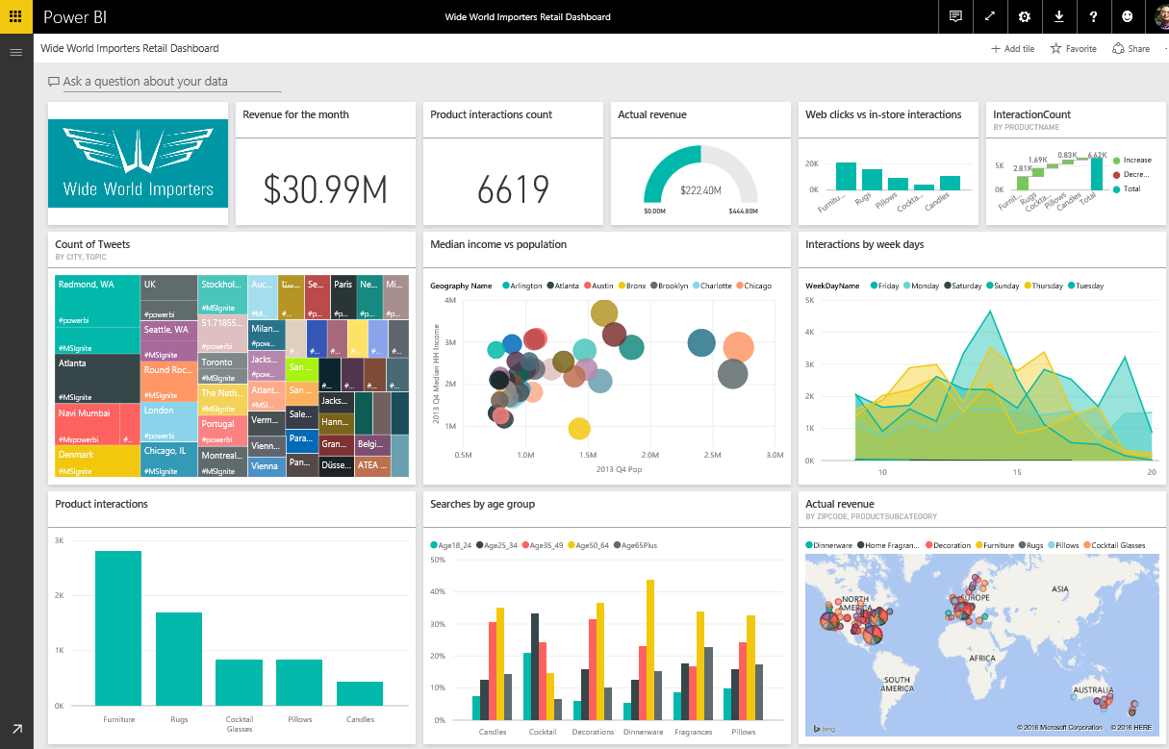
Connecting any user, in any business, anywhere, with their data
Power BI
Industry-leading SaaS service
5 seconds to sign up, 5 minutes to WOW
Large Power BI ecosystem
ISVs, SIs and partners creating unparalleled momentum
Integrated across Microsoft products
Customers benefit from integration with other Microsoft products
Notes:
Key message:
Power BI is a fundamentally groundbreaking offer
Talking points:
A service for non-technical business users and analysts to connect with their data
Users get value out of their data that was previously impossible, required complex technical expertise to connect with data, model the data, and create reports
Power BI connects any user, in every business, in every country with their data
Goal: connect 1B people to their data with Power BI
Power BI integration across Microsoft:
Connects to Azure Stream Analytics, Machine Learning, SQL Database, SQL Data Warehouse, SQL Data Lake, SQL Server, Office 365

Slide 7

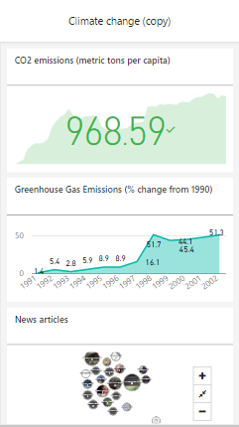
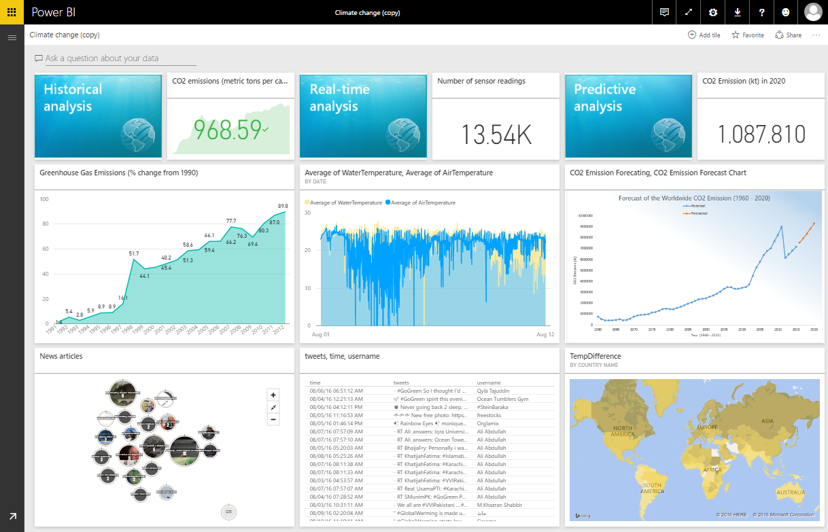
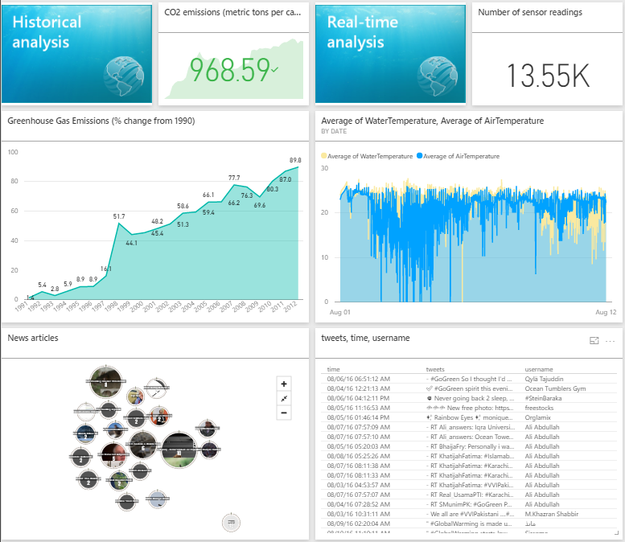

Key benefits and differentiators of Power BI
Pre-built dashboards and reports for popular SaaS solutions
Live, real-time dashboard updates
Secure, live connection to your data sources, on-premises and in the cloud
Auto insights and intuitive data exploration using natural language query
Integrated with familiar Microsoft products, utilizing commitment for scale & availability in Azure
Fast deployment, hybrid configuration, secure, and integrated with existing IT systems.
Notes:
Key message:
There are several capabilities that differentiate Power BI from other offerings in the market.
Talking points:
Power BI is a cloud-based analytics service that provides faster time to insight. It is used for visualizing, exploring and extracting insights from data. It brings together data from diverse sources to deliver rich, comprehensive views of business operations.
What that means is, with Power BI, you can see all of your data through a single pane of glass, and create an analytics environment in minutes to monitor data and share reports. Live dashboards and reports show visualizations and KPIs from data that reside both on-premises and in the cloud, providing a consolidated view across your business regardless of where your data lives.
There are several capabilities that are unique to Power BI – these include:
Pre-built dashboards and reports for popular SaaS solutions such as Marketo, Salesforce, GitHub, ZenDesk, Dynamics CRM, and many others.
Dashboards and visualizations that support real-time updates.
Secure, live connection to on-premises data sources to drive insight across the entire range of organizational information (Analysis Services, Azure SQL Database, SQL Database Auditing, Azure SQL Data Warehouse).
Automated scheduled refresh to keep Power BI data in sync with on premises data sources.
Native mobile applications for keeping users connected on the go.
Easy integration with other Microsoft offerings, from Excel to Azure services.
Intuitive data exploration, which enables users to ask questions of their data in plain English.
To summarize, Power BI is a SaaS offering that enables anyone to easily connect to their data, create live operational dashboards and explore data via interactive visualizations.

Slide 8



Power BI Overview
Power BI
Data sources
Power BI Service
Cloud-based SaaS solutions
e.g. Marketo, Salesforce, Quickbooks, Google Analytics, …
Content packs
Natural language query
Sharing & collaboration
On-premises data
e.g. Analysis Services, SQL Server
Organizational content packs Corporate data sources or external data services
Live dashboards
Visualizations
Azure services
Azure SQL, Stream Analytics…
Reports
Excel and CSV files
Workbook data, flat files
01001
10101
Power BI Desktop files
Data from files, databases, Azure, Online Services, and other sources
Datasets
Data refresh
Notes:
Let’s walk through an overview of what Power BI is.
1. The Power BI Service, sometimes referred to as powerbi.com, is what allows you to:
Create beautiful visualizations to tell compelling data stories.
Build rich, live dashboards that turn BI into business insights.
Create reports & datasets from which you can create visualizations and dashboards.
Enjoy the benefits of up-to-date data with real-time, automatic and scheduled refreshes.
Share dashboards easily with other people in your organization.
Ask questions of data in plain English with Natural Language Query.
Stay connected to data all the time with mobile applications.
2. Power BI connects to a variety of data sources. These range across both cloud and on-premises sources, and include:
A variety of popular SaaS solutions, such as Marketo, Salesforce, GitHub, Dynamics CRM, Zendesk, and several others.
On-premises databases – Power BI offers live connectivity to SQL Server Analysis Services and others, which we’ll cover in more detail later. And using a gateway solution, Power BI can connect to other database solutions.
Custom data sources – Power BI can connect to any data source you need it to thanks to its extensibility via REST APIs. This includes both proprietary corporate data sources, as well as external data services. For example, if you are a SaaS solution provider, you can work with Microsoft to connect your solution to Power BI.
Other Azure services – Power BI integrates tightly with SQL Azure and Stream Analytics, and will be integrating closely with more Azure services over time.
Power BI Desktop, Excel and CSV files – Excel workbooks can be directly connected to Power BI.com, or may be used with Power BI Desktop. Power BI Desktop is the companion application to the Power BI service – it is a desktop tool that supports data analysis and reporting. Like Excel files, or CSV files, Power BI Desktop files can be uploaded to the Power BI service.

Slide 9
Power BI Overview
Power BI
Data sources
Power BI Service
Cloud-based SaaS solutions
e.g. Marketo, Salesforce, Quickbooks, Google Analytics, …
Content packs
Natural language query
Sharing & collaboration
On-premises data
e.g. Analysis Services, SQL Server
Organizational content packs Corporate data sources or external data services
Live dashboards
Visualizations
Azure services
Azure SQL, Stream Analytics…
Excel and CSV files
Workbook data, flat files
Reports
01001
10101
Power BI Desktop files
Data from files, databases, Azure, Online Services, and other sources
Datasets
Data refresh
Power BI Desktop
Power BI Platform
Prepare
Explore
Report
Share
</>
embed, extend, integrate
Notes:
There is more….
3. Power BI Desktop is a visual data exploration tool that enables you to analyze data and create stunning reports. With Power BI Desktop, you are able to:
Acquire and prepare data using extensive query capabilities.
Manipulation and consolidation of multiple data sources is performed in Power BI Desktop – this enables Power BI service users to use data from multiple sources in a single report.
Establish data structure, then transform and analyze data.
Visualize and explore your data in new ways through a freeform drag-and-drop canvas.
Author reports with a broad range of modern data visualizations.
Publish beautiful, interactive reports directly to powerbi.com.
Securely share reports through unique, curated content library approach.
4. Finally, the Power BI Platform allows you to embed, extend, and integrate Power BI into other applications and environments.

Slide 10
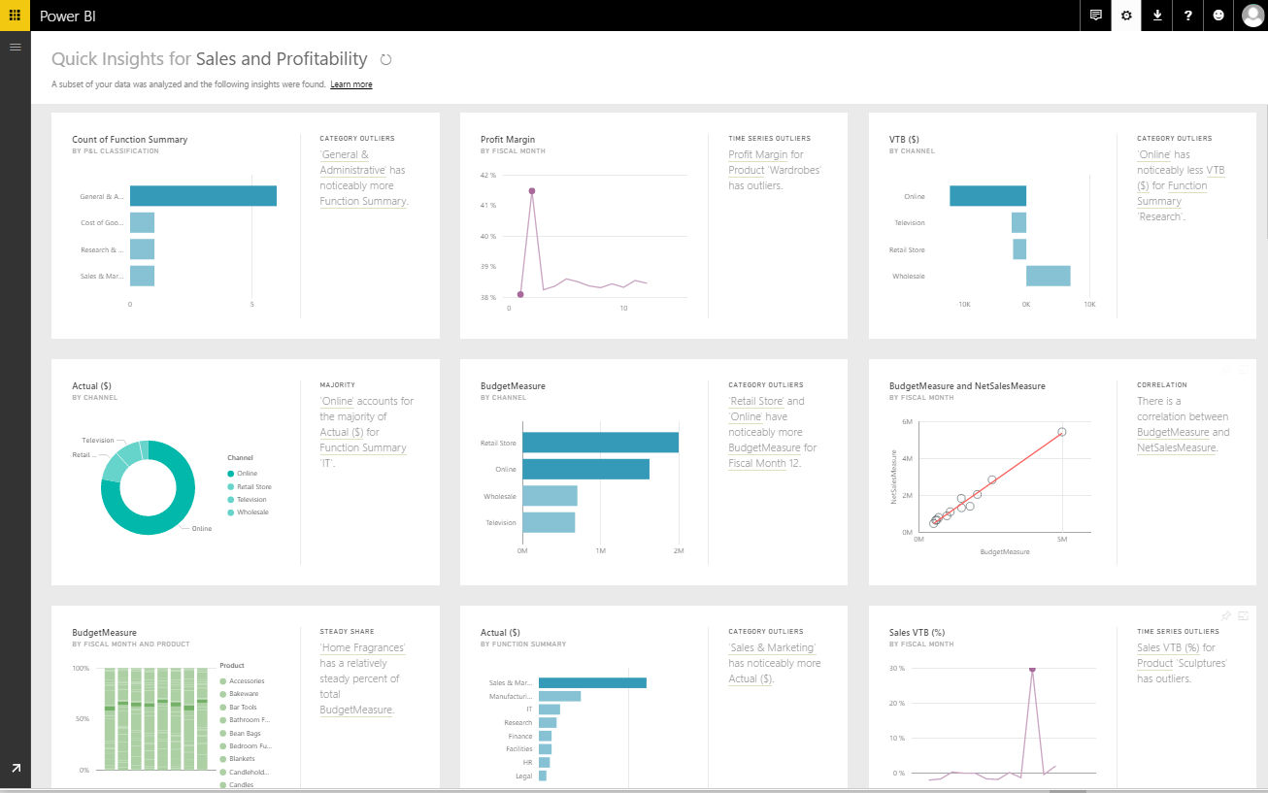
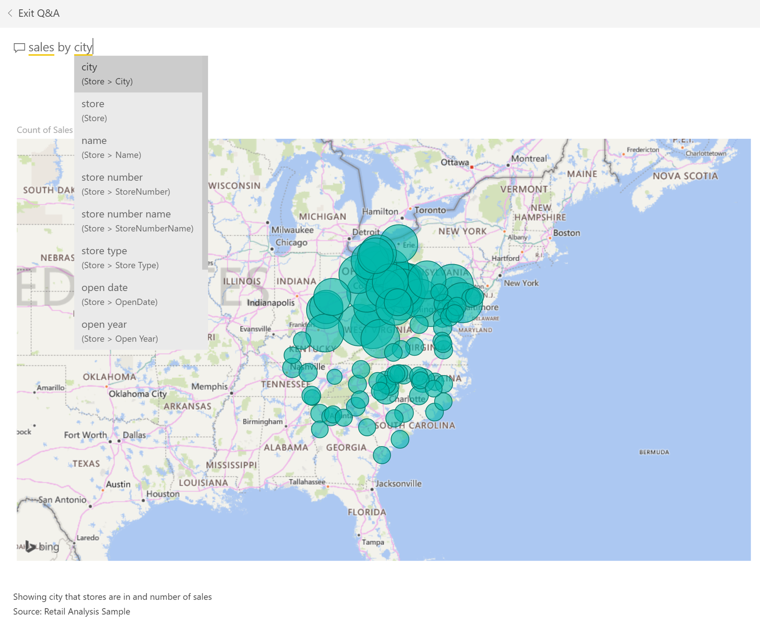
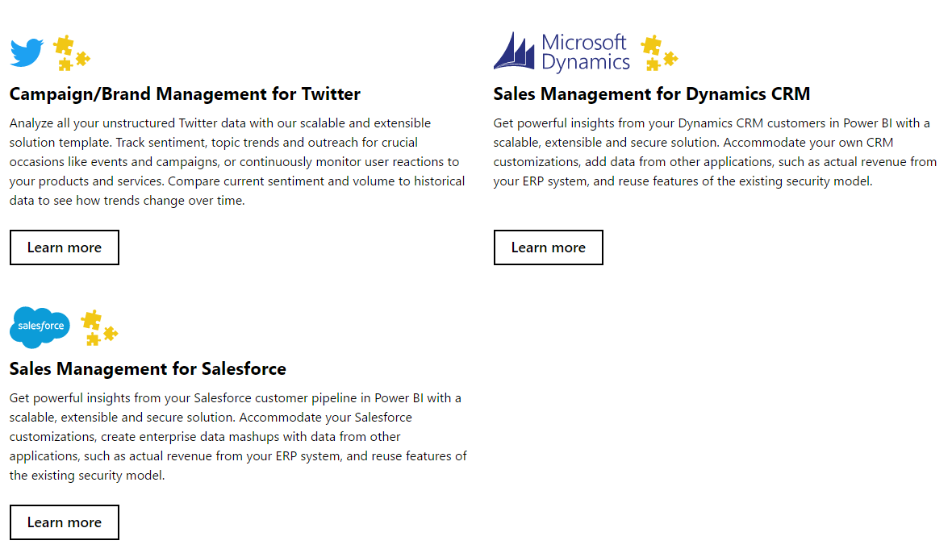
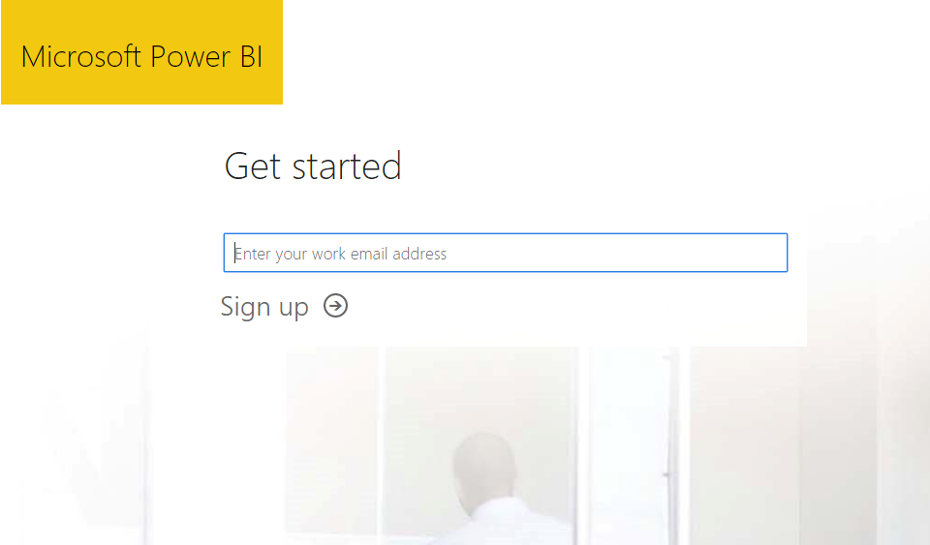
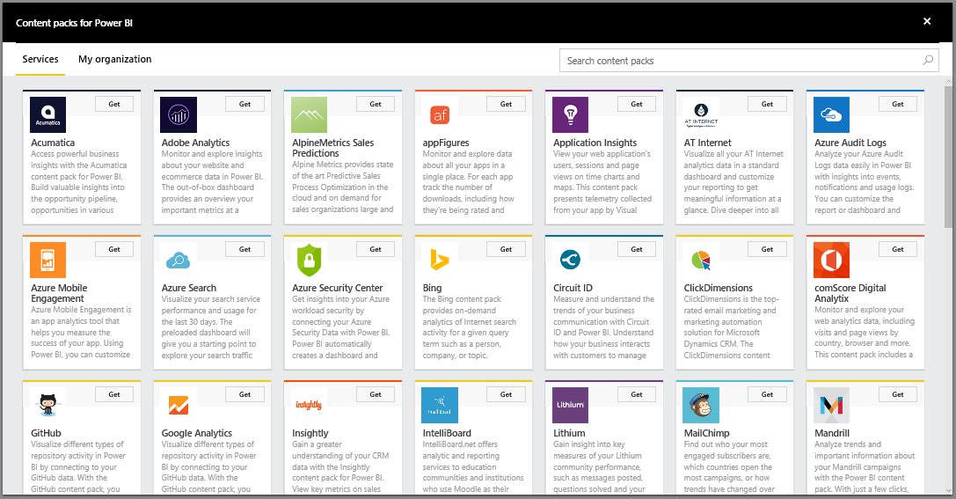
Get started quickly
Free sign up in seconds
Get started with pre-built content for popular SaaS solutions and for your organization
Content packs include pre-configured dashboards, reports, data models and queries
Automatic data refresh is built-in
Quickly provision end-to-end, enterprise-ready solutions with Solution Templates
Get instant answers from your data by asking a question in natural language
Use Quick Insights on a new data set - Power BI will analyze the data and deliver new insights
Notes:
Key message:
Get started quickly with the Power BI Service (powerbi.com) for faster decision-making by displaying all of one’s data in one place.
Talking points:
You can get started quickly with pre-built content packs for popular SaaS solutions.
The primary capability of Power BI is that it empowers you to create and customize live dashboards – dashboards that include visualizations from multiple data sources.
That is, dashboards can show different types of data from a variety of sources, and can use a range of unique visualizations.
If applicable, you can track status in real-time thanks to support for real-time data sources.
You have full control over your dashboards – pin any visualization from any report to any dashboard.
Click through visualizations to access underlying reports to discover more data and new insights.
Accelerate Power BI deployments with solution templates - you don’t need to start from scratch. Start with a working end-to-end enterprise-ready Power BI solution for Salesforce, Dynamics and Twitter

Slide 11
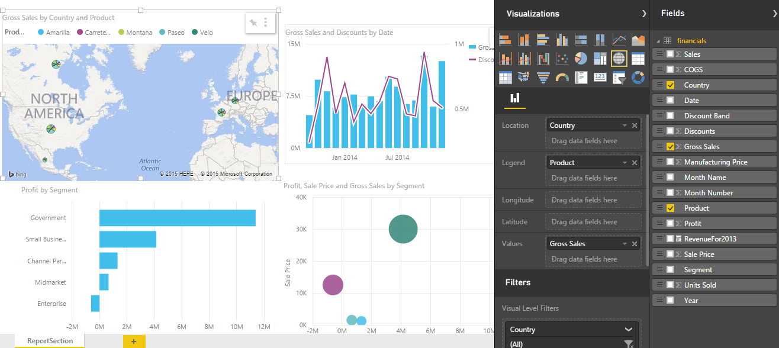
Create dashboards for what matters most
Build dashboards to monitor your most important business metrics, at a glance
Combine on-premises and cloud-born data in a single pane of glass
Data is visualized as tiles that you can resize, move, rename, pin, delete, or add a hyperlink
Choose different view modes (Full Screen, Fit to Screen, In-Focus)
Set your featured and favorite dashboards for what you visit the most
Add images, videos, web code or text boxes
Control the color scheme of your dashboard
Create dashboards by pinning visualizations from reports, Q&A, other dashboards, Reporting Services, Excel
Notes:
Key message:
With Power BI dashboards you can monitor your business through a single pane of glass
Talking points:
Create personalized dashboards to monitor your most important data, at a glance.
A dashboard combines on-premises and cloud-born data in a single pane of glass, providing a consolidated view across the organization regardless of where the data lives.
Each metric, or insight, is displayed on the dashboard as a tile.
Choose which dashboard to pin a visual to, either an existing visual or one that is created.
Pin a tile from one dashboard to another.
Dashboard display modes: Full Screen, Fit to Screen.
In-focus (full screen) mode for tiles.
Last update time and source information shown on tile in in-focus mode.
Control the visual colors in the dashboard. Dashboard theme can be different from report theme to achieve consistency across visuals.
More resize options for your tiles: choose from size 1x1 up to 5x5 tile units.
Add text, images, shapes, and videos to your dashboard
Set your featured and favorite dashboards
Receive data-driven alerts and other Power BI alerts in the Notification Center
Classify data, e.g. High Business Impact (HBI), Low Business Impact (LBI)

Slide 12
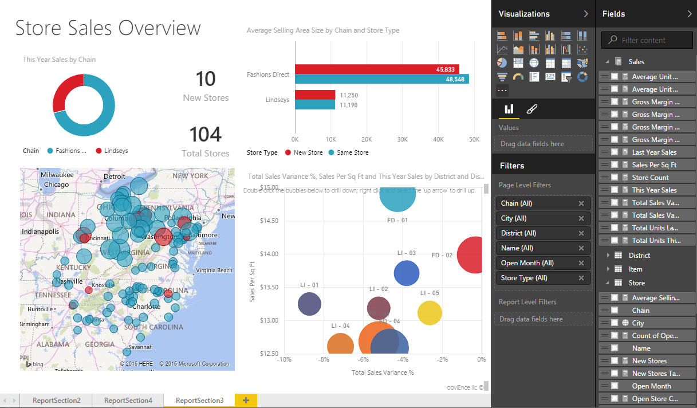
Explore your data and uncover new insights
Select a dashboard tile to go directly to the underlying report or Q&A
Dig deeper into reports (Reading View)
Reading View for reports that have been shared with you
Highlight a value in one visualization to change other visualizations
Drill-down in your hierarchical data
Filter, sort, hover over and highlight data
Control how a report is displayed
Explore and design a report (Editing View)
Editing View + Reading View for reports that you own
Create new visualizations
Use desired data fields for your visuals
Format your visuals – type, colors, filters
Add text and shape elements
Add new pages to your report
Notes:
Key message:
Power BI you can create reports from a dataset and surface them where you need them.
Talking points:
A report consists of a set of charts and other data visualizations, all drawing from the same underlying dataset.
Choose from different ways to build a report.
Create a report from scratch.
Select a read-only, pre-authored report.
Apply a default report format for an individual data set.
Generate as many reports as needed from a single data set.
Draw from a range of visualizations in any given report to tell a compelling data story— this applies to both new and existing reports.
Pin reports directly to dashboards to keep the right data top-of-mind.

Slide 13
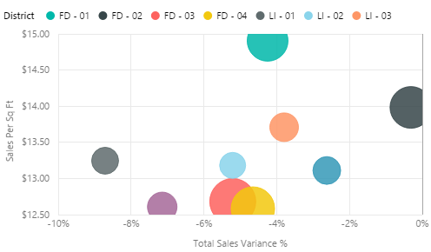
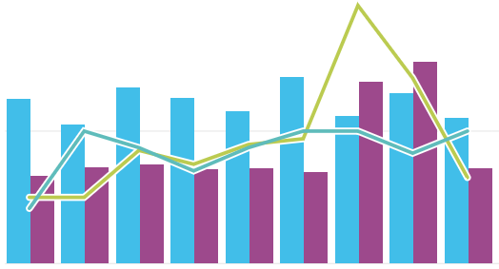

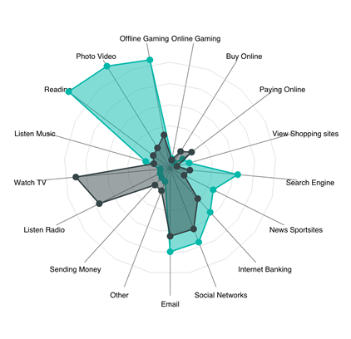
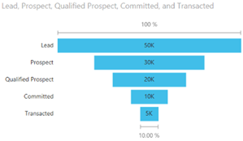
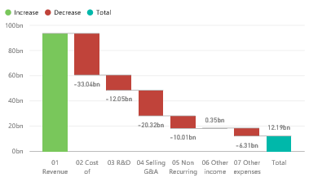

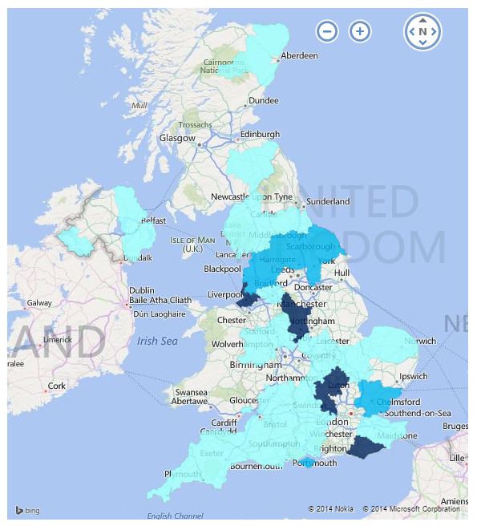
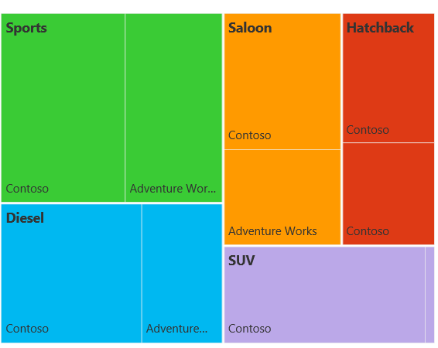
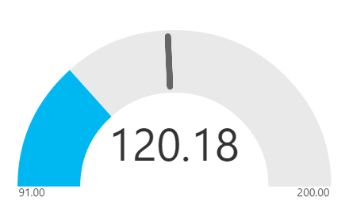
See your data the way you want it
Visualize data in a variety of ways
Growing number of visualization types
Donuts, basic area, waterfall, filled maps, tree maps, funnel, gauges combo charts, R charts and more
Custom visuals available from Power BI visuals gallery (visuals.powerbi.com)
Tools to develop, test, package new custom visuals
Visualizations on report page are connected – select value in one visualization to change other visualizations
Full screen pop out mode for report visuals to show additional details
Notes:
Key message:
See data the way you want it using the array of visualizations that are available in Power BI.
Talking points:
You can experiment with visualizing data in different ways, enabling previously inaccessible business insights.
Select from a growing number of visualization types and different chart types.
Use visualizations that go beyond standard charts – such as slicers, maps, tiles, stand alone images and others.
Cross-filter across visualizations within a report to surface new insights.
The Power BI visuals gallery at visuals.powerbi.com is enabled by the Power BI community. Browse through the visuals or submit one of your own for others to use.

Slide 14
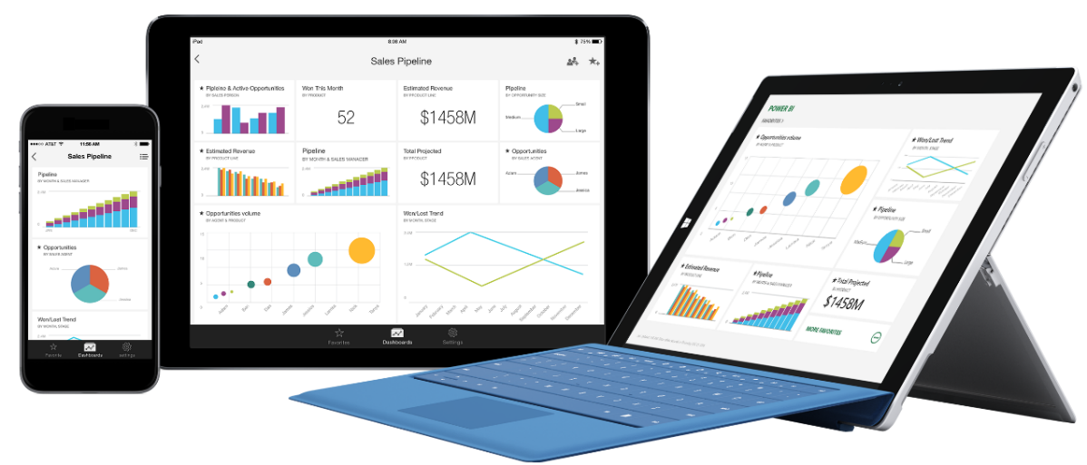
Stay connected from any device
Access Power BI dashboards and reports with native mobile apps for Windows, iOS and Android
Easy sign-in step with support for Single Sign-on (SSO)
Touch-optimized navigation for dashboards, tiles, and reports, zoom in and out of a visualizations and reports
Orientation-aware and location aware apps
Annotate visualization and share snapshot with others
Configure alerts to get notifications on critical KPIs
Generate and scan QR codes, or scan bar codes for report filtering
Open and interact with Reporting Services mobile reports and KPIs
Notes:
Key message:
Power BI mobile apps for Windows, iOS and Android make it possible to stay connected to dashboards and reports from any device.
Talking points:
Power BI native applications are available for Windows, iOS and Android devices.
These applications make it easy to access live dashboards and reports securely from anywhere.
Using the same app, you can also open and interact with SQL Server 2016 mobile reports and KPIs.
You can set favorites for easy access to the most important visualizations.
Zoom in and out of a visualization to look at data more closely or rotate the device for landscape/portrait views.
Annotate a report or visualization and share marked-up snapshot with others.
You can configure settings to receive alerts and notifications as data reaches or drops below pre-defined. thresholds, or based on other indicators.
If you are new to Power BI, activate your user account directly from one’s mobile device.
Optimized formatting and display of charts, including % based line charts and data labels.
Improve the scroll and touch gestures of the matrix tile. Easily scroll down one’s matrix tile and get all the data natively and mobile optimized.
Global search and recent items
Multi-select for report slicers
Generate and scan QR codes, use QR codes with augmented reality display
Scan bar codes
Windows phone: pin KPI, card, or multi-row card as live tile directly to Start screen

Slide 15
Ask questions of your data - the way you would ask a person
Type questions in plain language – Power BI Q&A will provide the answers
Q&A will provide suggested questions, terms and visuals for your dataset
Q&A intelligently filters, sorts, aggregates, groups, and displays data based on the question
Pin the answers to your dashboard
Add your own suggested questions to dataset, e.g. frequently asked questions
Notes:
Key message:
One of the unique capabilities of Power BI is that it lets you ask questions of your data the same way you’d ask a person
Talking points:
Now, even the least quantitatively inclined person can find answers quickly by phrasing data questions in plain English.
Type a question, and powerbi.com answers by generating a relevant chart.
Pin the subsequent chart directly on a dashboard.
Enable the best results by using key phrasing as you build models in Power BI Desktop.
Power BI’s Natural Language Query, or Q&A feature, intelligently filters, sorts, aggregates, groups and displays data based on the key words in the question asked.
By default, you will see a list of suggested questions for tiles on your dashboard or tables in your dataset.
Suggestions will include specific terms from the data (e.g. column names or row values).
Add your own featured questions, e.g. frequently asked questions to your dataset.

Slide 16
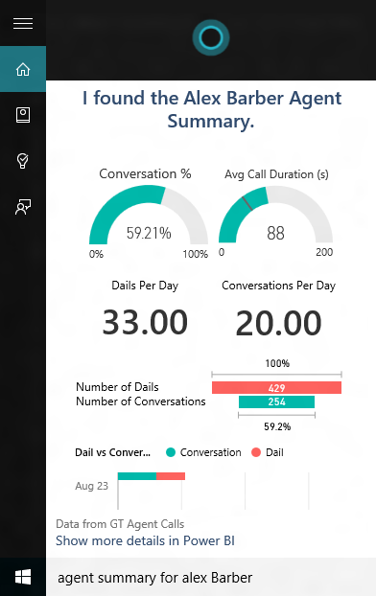
Power BI Cortana Integration
Cortana can find answers from data in Power BI, e.g.
“What were our biggest deals that closed last month?”
Similar to Q&A, ask or type a question in natural language
Cortana can find answers directly from dataset or from report pages designed for Cortana (called Answer Pages)
Interact with the visualizations as you would in Power BI, to further explore an answer, simply open a result in Power BI
Cortana ranks the answers from Power BI, giving you one or more best matches
Easily create Answer Pages in the Power BI service
Notes:
Key message:
With the November 2015 update of Windows 10, Cortana can now find answers from data stored in Power BI
Talking points:
To use Cortana to get answers from Power BI, all that is required is to add the work or school account you use with Power BI to Windows 10 and have access to a dataset in Power BI that is enabled for Cortana.
Similar to Power BI Q&A, ask or type your questions using natural language. Cortana will search your Cortana-enabled datasets in Power BI for answers and display results directly in your Windows 10 device.
Cortana can find answers either directly from datasets in Power BI or from report pages published to Power BI and designed specifically for Cortana (called Answer Pages). Interact with the visualizations as you would in Power BI or, to further explore an answer, simply open a result in Power BI.
NOTE: Only datasets hosted in Power BI are supported. Cortana with Power BI does not work with DirectQuery or other direct-connect datasets.
Cortana ranks the answers from Power BI, giving you one or more best matches if there is high confidence a result is a good answer. Other potential answers from Power BI are listed in a Power BI section below any best matches.
More exciting features will soon be available with the Power BI Cortana integration, including predictions, preemptive alerts and line of business process integration.

Slide 17
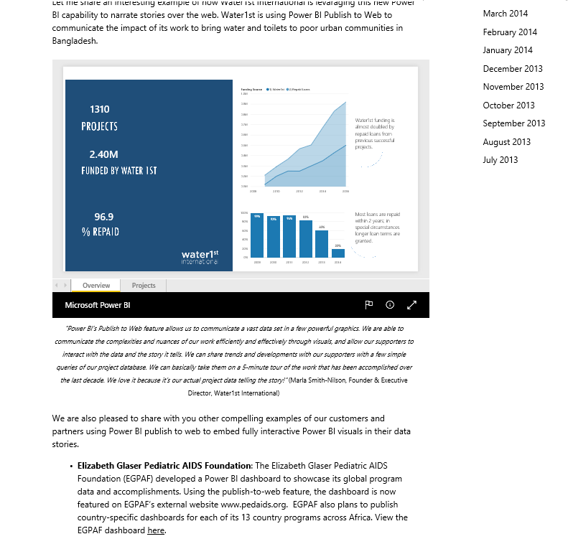
Share your work and collaborate with others
Share a dashboard with colleagues and others
Colleagues in and out of your organization can interact and view dashboards and associated reports (read-only)
Control re-sharing of dashboard
Collaborate in a group workspace
Everyone in group can view and edit dashboards and reports
Members can be restricted to view only
Create a content pack and publish it to your organization
Any user with access to content pack can view and create personalized copies of dashboard, reports
Publish to Content Pack library to share with entire organization or groups
Publish to web
Embed interactive visuals into blog posts, websites, social media, and other online communications, on any device.
Available on reports in your personal workspace that you can edit
Notes:
Key message:
In Power BI you can share dashboards, reports, and tiles in several different ways. Each has its advantages.
Talking points:
Share a dashboard with colleagues and others
When you share a dashboard, those you share it with can view it and interact with it, but can't edit it. They can see the same data that you see in the dashboard and reports. Your colleagues can share the dashboard with other colleagues, if you allow them to. Those outside your organization can view and interact with the dashboard, but can't share it..
Make changes to dashboard after you’ve sent it out, and it will automatically sync across all users
Share only your dashboard, keeping access to the source data and reports secure. What this means: Users who receiving a sharing invitation cannot change filters or drill down into data - they only see what’s in the dashboard
Manage who can re-share dashboards with others
Share dashboards based on email or O365 distribution group
Share without email notification, copy and share a link instead, e.g. on another portal
People picker with autocomplete as you start typing the name of recipients
Copy/paste large number of email addresses you want to share with, e.g. copy directly from Outlook
Collapse navigation pane with URL parameter
Collaborate in a group workspace
Groups in Power BI are built on Office 365 groups, so you and your colleagues need a Power BI Pro license. When you're a member of a group, you can create a dashboard in the group workspace. Everyone in the group can view, interact with, and edit the dashboard and its reports. They have the same permission you have
Create a content pack and publish it
Content packs are a great way to share your Power BI insights with your colleagues.
You create a dashboard with its reports and datasets, and then publish them all together as a content pack -- either for your whole organization or for those in a specific security group or distribution list. When those colleagues go to the Content Pack Library for their organization, they see your content pack along with any others they have permission to see
Publish to the web
When you publish Power BI reports to the web, you can embed interactive visuals in blog posts, websites, social media, and other online communications, on any device. Publishing to web is available on reports in your personal workspace that you can edit. You can't publish to the web reports that were shared with you.

Slide 18
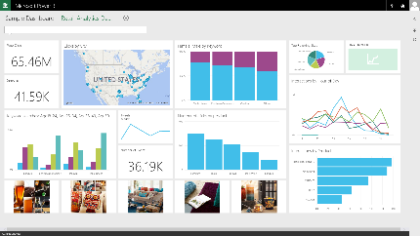
Keep your data where it is and connect securely
Faster time to insight with a hybrid BI solution
Cloud data sources
SaaS sources
Azure – SQL, DW, Blob, Table, HDInsight, Marketplace
SharePoint, web sources, OData
OneDrive
On-premise data sources
SQL Server, Teradata, Oracle, DB2, MySQL, PostgreSQL, Sybase, SAP HANA, Access, Custom SQL, Custom ODBC Drivers
SQL Server Analysis Services (tabular and multi-dimensional)
Files/folder, SharePoint on-premises
Live Power BI Dashboards and Reports
SaaS, Azure, SharePoint, Web, OneDrive
Cloud
On-premises
SQL Server Analysis Services
Data Source
Data Source
Notes:
Key message:
Power BI makes it possible to keep your data where it is – on-premise or in the cloud.
Talking points:
Connect to the SaaS solutions that you already use.
Connect to Azure SQL Server, Azure SQL Data Warehouse, Spark on HDInsight using DirectQuery. With DirectQuery, queries are sent back to your Azure data store in real time as you explore the data. This, combined with the scale of Azure, enables users to create dynamic reports in minutes against terabytes of data.
Connect live to your on-premise SQL Server Analysis Services data models – both tabular and multidimensional.
Connect live to your SQL Server, Teradata, Oracle DB2, MySQL, PostgreSQL, Sybase, SAP HANA, Access databases.

Slide 19
Keep your data up-to-date
Access and refresh the data via
Direct Query to cloud and on-premise data sources
Live connectivity to Analysis Services
Import, with scheduled refresh
REST APIs to stream data
Refresh on-premise data with
Power BI Personal Gateway
On-Premises Data Gateway
Live Power BI Dashboards and Reports
SaaS, Azure, SharePoint, Web, OneDrive
Live Query
Direct Query
Scheduled Refresh
Cloud
On-premises
SQL Server Analysis Services
Data Source
Data Source
Notes:
Key message:
Power BI makes it possible to keep all your data current – and visualizations automatically recalibrate when data changes.
Talking points:
Refresh your Azure SQL Server, Azure SQL Data Warehouse, Spark on HDInsight data using DirectQuery. With DirectQuery, queries are sent back to your Azure data store in real time as you explore the data. This, combined with the scale of Azure, enables users to create dynamic reports in minutes against terabytes of data.
With SaaS solutions, data is refreshed automatically, typically on a daily basis.
Data may also be refreshed on demand.
And even without user intervention, data is queried every 10 minutes to keep the dashboard up-to-date.
Use live connectivity to SQL Server Analysis Services (SSAS) to see updates in your Power BI dashboard/report as the user interacts with it.
Get real-time visibility via integration with Azure Stream Analytics, or by pushing data into Power BI using REST APIs.
With the Personal on On-Premises Data Gateway, you can schedule refreshes for your on-premises databases.
Row level security: Re-use on-premise role based row level security for Analysis Services.

Slide 20
For the Business Analyst: Data refresh with Power BI Personal Gateway
Personal Gateway empowers the business analyst to securely and easily refresh on-premise data
Self-service data refresh - no help from IT required
Easy & simple to use - lightweight one-click installer
One Personal Gateway per user
Runs either as a service or an app
Import of data with scheduled refresh
Live Power BI Dashboards and Reports
Scheduled Refresh
Installed locally
Cloud
Personal Gateway
On-premises
Data Source
Data Source
Data Source
Notes:
Key message:
Personal Gateway is required to refresh datasets from a supported on-premised data source in your organization.
Talking points:
Personal Gateway is available with Power BI Pro.
Anyone can refresh. With Personal gateway, everyone can keep their data in Power BI in sync with their on-premises sources.
No IT Dependency.
Easy & simple to use. Personal Gateway is a lightweight one-click installer and once it is up and running on your computer; data refresh is seamless.
The Gateway supports REFRESH NOW and a SCHEDULE REFRESH. The data is cached.
Data transfer is secure. Data transfer between Power BI and the gateway is secured through Azure Service Bus. The Service Bus creates a secure channel between the Power BI service and your computer. Because the gateway provides this secure connection, there’s usually no need to open a port in your firewall.

Slide 21
For IT: Centralized data access with On-Premises Data Gateway
IT can centrally manage access control to data sources
BI governance: IT can monitor and audit usage
Supports live, interactive query to on-premises data sources (e.g. SQL Server) and scheduled refresh
One gateway for multiple cloud services and experiences
Supported services: Power BI, PowerApps, Microsoft Flow, Azure Logic Apps
PowerApps
Live Power BI Dashboards and Reports
Microsoft Flow
Azure Logic Apps
Scheduled Refresh
Manage & Monitor
Cloud
On-Premises Data Gateway
On-premises
Data Source
Data Source
Data Source
Notes:
Key message:
Enables IT departments to centrally deploy and manage on-premise data access, for a large group of users.
Talking points:
Centralized way to refresh content in Power BI
Configure, manage and maintain a group of On-Premises Data Gateways. Transparently refresh data uploaded to Power BI for the business users and analysts.
Centralized access control
Centrally manage the set of users who can access the underlying data sources. Assign user permissions.
Enables BI governance – empower IT to monitor and audit usage
Gain visibility into Data Gateway usage, such as commonly accessed data sources, and the users accessing them.
Direct access
Direct access to a wide range of data sources, like SQL Server, SQL Server Analysis Services.
Secure data transfer
Data transfer between the Power BI service and the gateway is secured through Azure Service Bus. The Service Bus creates a secure channel between the Power BI service and your computer. Because the gateway starts this secure connection, there’s usually no need to open a port in your firewall because it is an outbound connection.

Slide 22
Power BI Pro
Power BI Pro
Data capacity
10 GB/user
Data refresh
Up to 8 x per day
Consume streaming data 1M rows/hour
Live data sources
Access on-premises data with Gateways
Collaboration features
Collaborate with your team using O365 groups
Organizational content packs
Access control and sharing with AD groups
Shared data queries through data catalog
Power BI Pro offers additional collaboration, data refresh and data capacity features
Power BI Pro is available as 60-day trial
Guided purchasing experience at powerbi.com/pricing
Individuals can purchase Power BI Pro
Power BI Pro is included in new O365 E5 plan
Notes:
Key message:
Power BI Pro has all the features of the free version of Power BI, and additional collaboration and data refresh features. It also has higher data capacity and data streaming limits.
Talking points:
60-day free trial of Power BI Pro, extension on request.
Create and publish customized content packs.
Share refreshable team dashboards and reports using groups.
Connect to on-premises data using Personal Gateway.
Live connectivity to to the following sources: SQL Server Analysis Services, Spark on Azure HDInsight, Azure SQL Data Warehouse, Azure SQL Database.
For latest pricing see https://powerbi.microsoft.com/en-us/pricing.

Slide 23
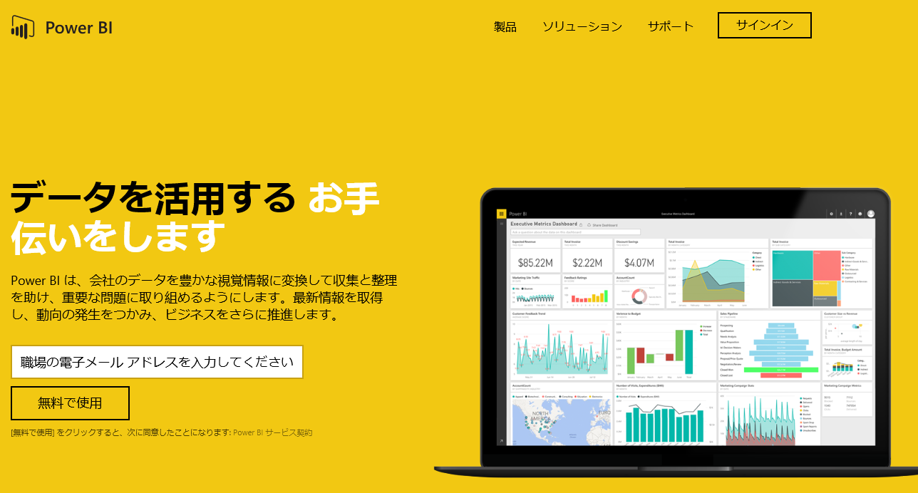
Supported languages and countries for Power BI
Power BI is available in 42 languages (Service and Desktop)
Translated:
Menus, buttons, messages, other UX elements
Based on language preferences in browser settings
In English only:
Dashboards and reports based on SaaS content packs
Exploring data with Q&A
Help content for Power BI
Please refer to powerbi.com for supported languages and countries
Notes:
Key message:
Power BI (in your browser) is available in 42 languages.
Talking points:
Supported languages:
For latest list see https://support.powerbi.com/knowledgebase/articles/559626-supported-languages-and-countries-regions-for-powerbi.

Slide 24
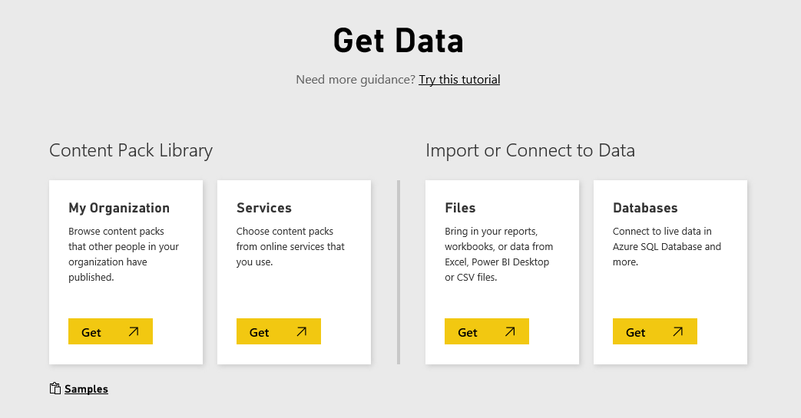
Data sources
Built-in connectivity for all your data
SaaS solutions
e.g. Marketo, Salesforce, Quickbooks, Google Analytics…
Data from services
Content packs for SaaS services that you already use, e.g. ….
Growing number of supported SaaS solutions
Data from databases
Cloud: Azure SQL Database, Azure SQL Data Warehouse, Spark on HDInsight
On-premise: SQL Server Analysis Services tabular or multi-dimensional, SQL Server, SAP HANA, Oracle, Teradata (Gateway required)
Data from your organization
Content published by others in your org (organizational content packs)
Data from files
Import data from Excel, Power BI Desktop, or CSV files
Connect, manage and view Excel in Power BI
On-premises Data
Organizational Corporate data sources or external data services
Azure services
Azure SQL, Stream Analytics…
Excel and CSV files
Power BI Desktop files
Data from files, databases, Azure, and other sources
Notes:
Key message:
Power BI connects to a variety of data sources, enabling you to view and explore data from hybrid sources in a single location.
Talking points:
The Power BI Get Data feature lets you quickly and easily connect to all of your data.
This includes a range of both cloud sources, on premises sources and specific data files —from the SaaS solutions you already use to your organization’s on-premises data.
Many sources have been integrated with Power BI, connecting in minutes with pre-built dashboards and reports.
For the first time, you can easily get a consolidated view of your data, no matter where the data actually lives.

Slide 25
Data sources
Start discovering business insights right away
SaaS solutions
e.g. Marketo, Salesforce, Quickbooks, Google Analytics
Connect to cloud services you already use - popular SaaS solutions
Quickly start with solution-specific content packs which include
pre-configured dashboards
reports
data models and queries
Explore data with fast data processing
Automatic data refresh is built-in
On-premises Data
Organizational Corporate data sources or external data services
Azure services
Azure SQL, Stream Analytics…
Excel and CSV files
Power BI Desktop files
Data from files, databases, Azure, and other sources
Please refer to powerbi.com for latest list of SaaS partners
Notes:
Key message:
Power BI connects to the SaaS services that you already use with pre-configured dashboards, reports, and data models.
Talking points:
It’s easy to discover business insights quickly by connecting all of the SaaS data sources you already use to Power BI.
Power BI has “connector” functionality that establishes a direct connection to a variety of popular SaaS solutions.
View all of the available content packs by logging into Power BI. New content packs are added regularly.
It’s more than just a connection though – Power BI has a “content pack” for each SaaS solution.
These “content packs” consist of pre-configured dashboards, reports, data models, embedded queries and metadata.
That means users don’t have to set anything up from scratch – you connect your data and instantly have a beautiful dashboard ready for you to customize to your needs.
Thanks to the direct connection from Power BI, data processing is optimized, so you can explore at a rapid pace.
And data is updated automatically each day (or on-demand if you need it) – no need for special refresh configuration.

Slide 26
Data sources
Connect live to your on-premises data
SaaS solutions
e.g. Marketo, Salesforce, Quickbooks, Google Analytics…
Connect directly to your existing on-premises data sources:
Analysis Services (tabular and multidimensional)
SQL Server
SAP HANA
Oracle
Teradata
Requires On-Premises Data Gateway
Role-based and row-level data security is applied
Data remains on-premise, only query is stored in Power BI
Live Power BI Dashboards and Reports
PowerApps
On-premises Data
Microsoft Flow
Azure Logic Apps
Organizational Corporate data sources or external data services
Scheduled Refresh
Manage & Monitor
Cloud
On-premises
Azure services
Azure SQL, Stream Analytics…
On-Premises Data Gateway
Data Source
Data Source
Excel and CSV files
Power BI Desktop files
Data from files, databases, Azure, and other sources
Notes:
Key message:
Connect live to your existing on-premises data, such as SQL Server Analysis Services or SQL Server. No need to move your data to the cloud.
Talking points:
Power BI lets you establish live connectivity with on-premises SQL Server Analysis Services tabular and multi-dimensional models.
Use On-Premises Data Gateway to configure the connection with your existing SSAS solution (replaces the Analysis Services Connector).
The connection is live – meaning that when users view and explore dashboards, Power BI interactively queries the on-premises cube to fetch the data right then.
This enables efficient data exploration thanks to optimized query performance.
You can create reports with SSAS data on powerbi.com, even while data remains on-premises.
Your existing, role-based SSAS permissions, still apply – user access to SSAS data via Power BI is controlled the same way.
The connection to SSAS is secured via Azure Service Bus SSL encryption.

Slide 27
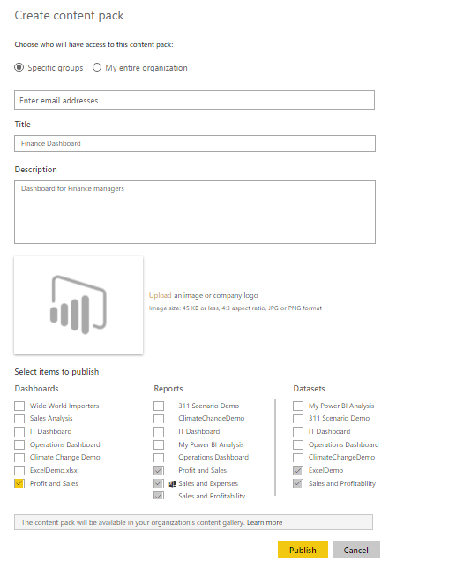
Data sources
Get immediate insights into your organization
SaaS solutions
e.g. Marketo, Salesforce, Quickbooks, Google Analytics
Content packs make it easier and faster for users to explore the data
Content packs include
pre-built dashboards
reports
pre-defined data models
Package up and share your own dashboard, reports, and datasets with your coworkers
On-premises Data
Global Sales
Organizational Corporate data sources or external data services
Azure services
Azure SQL, Stream Analytics…
Excel and CSV files
Power BI Desktop files
Data from files, databases, Azure, and other sources
Notes:
Key message:
If your organization needs to connect to a data source that isn’t yet integrated with Power BI, no problem – that’s what custom “connectors” and content packs can address.
Talking points:
Using the Power BI REST API library, developers can create custom “connectors” – i.e. codes that integrate nearly any data source with Power BI.
If you offer a data service, whether that’s a SaaS solution, industry-specific data, or some other type of service, a custom connector enables your customers to pull data into Power BI. This gives them more opportunity to use your service and realize additional value.
If you need to make data available across your organization, a custom connector can do just that in an efficient way. For example, your finance team can provide access to financial data to the appropriate users across the organization.
In addition to connecting your data source, Power BI REST APIs enable you to create and publish organizational content packs, which consist of pre-built dashboards, reports, data models, embedded queries, and metadata.
Content packs make it easier and faster for users to explore the data you’re providing – they get dashboards and reports that they can use immediately to drive insights.
With connectors and content packs, users can also use data from custom sources alongside other data, giving them an even more comprehensive picture of what they need to manage.

Slide 28







Data sources
Consume structured/unstructured data with Azure services
SaaS solutions
e.g. Marketo, Salesforce, Quickbooks, Google Analytics
Connect directly to data from Azure services, including
Azure SQL Database
Azure SQL Data Warehouse
Spark on HDInsight
Push live, streaming data from Azure Stream Analytics with built-in destination for Power BI for real-time dashboards at any scale
Integration with other Azure services, including Azure Machine Learning, opens up new scenarios, without writing thousands of lines of code
On-premises Data
Event Hubs
Stream Analytics
Organizational Corporate data sources or external data services
Machine Learning
Power BI
Azure services
Azure SQL, Stream Analytics…
Storage
SQL Server
Excel and CSV files
HDInsight
Power BI Desktop files
Data from files, databases, Azure, and other sources
Notes:
Key message:
Power BI integrates with select Azure services, enabling you to build seamless end-to-end data solutions.
Talking points:
For example, Power BI integrates with SQL Database and SQL Data Warehouse, making it easier to query large data sets in real-time.
Power BI also directly integrates with Azure Stream Analytics - real-time data from Stream Analytics can be pushed directly into Power BI for real-time visibility via dashboards.
For example, if you have IoT devices like sensors and factory-floor machines connected to Stream Analytics, that data can be surfaced live to Power BI dashboards, so operations managers can get real-time information on the status of plant operations.

Slide 29
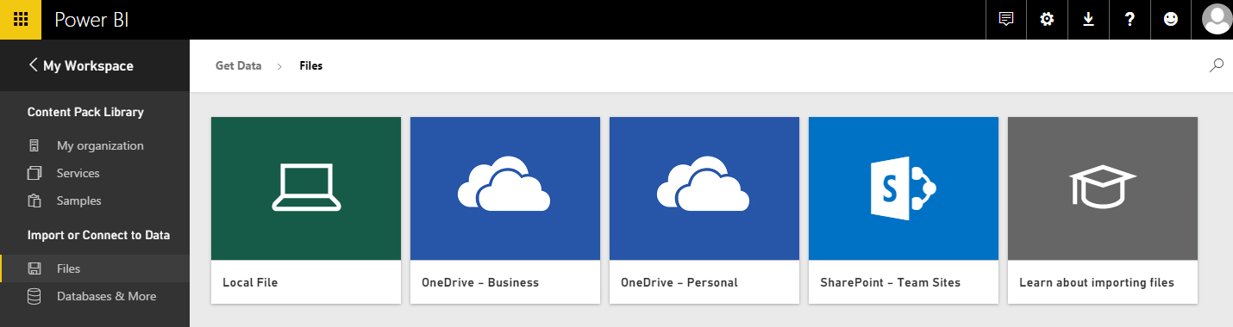
Data sources
Connect to your data from files
SaaS solutions
e.g. Marketo, Salesforce, GitHub, Google Analytics
Import data into Power BI from files
Microsoft Excel (xlxs or xlsm)
Power BI Desktop (pbix)
Comma Separated Value (csv)
Files can be located on
Local machine
OneDrive Business or Personal
SharePoint Team Sites
Two ways to use Excel files
Import into Power BI
Connect (or upload), manage and view in Power BI
Any changes to a file in OneDrive or SharePoint are synced automatically (hourly)
Data and reports from Power BI Desktop files
On-premises Data
Organizational Corporate data sources or external data services
Azure services
Azure SQL, Stream Analytics…
Excel and CSV files
Power BI Desktop files
Data from files, databases, Azure, and other sources
Notes:
Key message:
You can upload Excel, CSV and Power BI Desktop files from your computer, or connect to them on OneDrive for Business, OneDrive Personal or SharePoint Team Sites.
Talking points:
Where your file is saved makes a difference.
Local - If you save your file to a local drive on your computer or another location in your organization, from Power BI, you can import your file into Power BI. Your file will actually remain on your local drive, so the whole file isn’t really imported into Power BI. What really happens is a new dataset is created in your Power BI site and data, and in some cases the data model are loaded into the dataset. If your file has any reports, those will appear in your Power BI site under Reports.
OneDrive - Business – If you have OneDrive for Business and you sign into it with the same account you sign into Power BI with, this is by-far the most effective way to keep your work in Excel Power BI Desktop, or a CSV file and your dataset, reports, and dashboards in Power BI in-sync. Because both Power BI and OneDrive are in the cloud, Power BI connects to your file on OneDrive about every hour. If any changes are found, your dataset, reports, and dashboards are automatically updated in Power BI.
OneDrive - Personal – If you save your files to your own OneDrive account, you’ll get many of the same benefits as you would with OneDrive for Business. The biggest difference is when you first connect to your file (using Get Data > Files > OneDrive – Personal) you’ll need to sign in to your OneDrive with your Microsoft account, which is usually different from what you use to sign in to Power BI. When signing in with your OneDrive with your Microsoft account, be sure to select the Keep Me Signed In option. This way, Power BI will be able to connect to your file about every hour and make sure your dataset in Power BI is in-sync.
SharePoint Team-Sites – Saving your Power BI Desktop files to SharePoint – Team Sites is much the same as saving to OneDrive for Business. The biggest difference is how you connect to the file from Power BI. You can specify a URL or connect to the root folder.
Two ways to use Excel workbook in Power BI
Import - When you import, any supported data in tables and/or a data model are imported into a new dataset in Power BI. If you have any Power View sheets, those will be re-created in Power BI as reports.
You can continue editing your workbook. When your changes are saved, they’ll be synchronized with the dataset in Power BI, usually within about an hour. If you need more immediate gratification, you can just click Publish again, and your changes are exported right then and there. Any visualizations you have in reports and dashboards will be updated, too.
Choose this option if you’ve used Get & Transform data or Power Pivot to load data into a data model, or if your workbook has Power View sheets with visualizations you want to see in Power BI.
In Excel 2016, you can also use Publish > Export. It's pretty much the same thing.
Connect, manage and view Excel in Power BI - when you connect, your workbook will appear in Power BI just like it would in Excel Online. But, unlike Excel Online, you’ll have some great features to help you pin elements from your worksheets right to your dashboards.
You can’t edit your workbook in Power BI. But if you need to make some changes, you can click Edit, and then choose to edit your workbook in Excel Online or open it in Excel on your computer. Any changes you make are saved to the workbook on OneDrive.
When choosing this way, no dataset is created in Power BI. Your workbook will appear in your Power BI workspace navigation pane under Reports. Connected workbooks have a special Excel icon.
Choose this option if you only have data in worksheets, or you have ranges, PivotTables and charts you want to pin to dashboards.
In Excel 2016, you can also use Publish > Upload. It's pretty much the same thing.

Slide 30
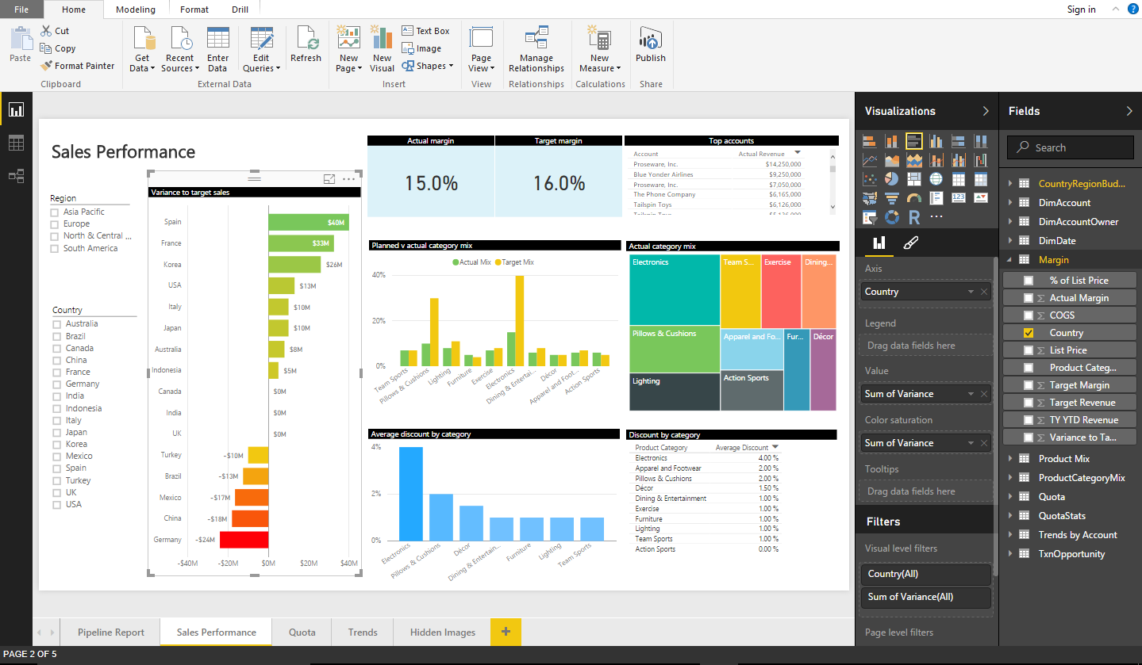
Create Power BI Content Connect to data and build reports for Power BI
Power BI Desktop
Companion to the Power BI Service
For Business Analysts
Rich report authoring tool with direct publish to Power BI service
Built-in data access, mashups, and transformation capabilities
Updated regularly
Notes:
Power BI Desktop is a visual data exploration and interactive reporting tool, providing a free-form canvas for drag and drop exploration of your data, an extensive library of interactive visualizations, and an authoring experience for ease of report creation for the Power BI service.
A freely downloadable 32/64bit desktop application optimized for use the Power BI Service
Combines the Power of Power Query, Power Pivot and Power View
Specializing in Interactive Visualization and Analysis.
Main output: Interactive Reports
Effortlessly publish interactive visual reports to users of Power BI
Updated on monthly basis
Excel 2013 is Microsoft’s premier business analyst tool – it includes rich business intelligence features (Power Query, Power Pivot, Power View, Power Map) fully integrated with the powerful ad hoc analysis capabilities and familiar features of Excel – like Pivot Tables and Excel Charting. With Excel 2013, analysts can publish Excel Workbooks to Power BI, sharing data, analysis and reports with users of Power BI.
For customers who don’t have access to Excel 2013, the new Power BI Desktop can be used to import and model data, then author and publish Power BI Reports to the Power BI service. While lacking the rich analytical features of Excel, it does provide a simple solution expressly designed for Power BI content creation.

Slide 31
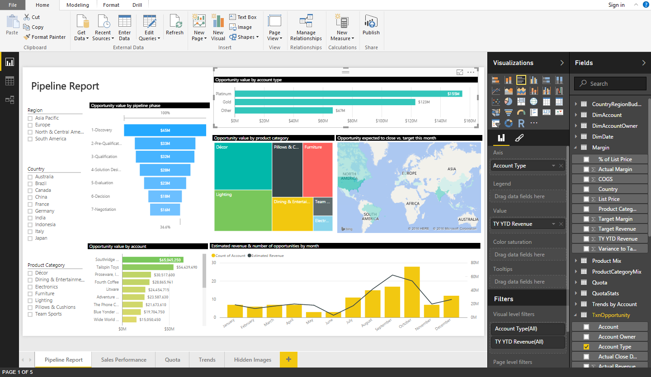
Prepare, explore, report and collaborate with Power BI Desktop
Power BI Desktop
Acquire and prepare data with extensive query capabilities
Establish data structure and transform and analyze data
Explore data in new ways through a freeform, drag-and-drop canvas
Run R scripts directly in Power BI Desktop
Author reports with a broad range of modern data visualizations
Prepare
Explore
Report
Share &
collaborate
Notes:
1) Data preparation…. Get data, then transform and model
2) Exploration: Free form data exploration, canvas experience.
3) Report … Create interactive reports
4) Share and collaborate with Power BI
Power BI Desktop is a free desktop companion application for the Power BI service. It enables visual data exploration and report-authoring. Complementary to Excel, it combines the capabilities of Power Query, Power Pivot & Power View into a single interface.
With Power BI Desktop, you can:
Acquire and prepare data using extensive query capabilities
Manipulation and consolidation of multiple data sources is performed in Power BI Desktop – this enables Power BI service users to use data from multiple sources in a single report
Establish data structure, then transform and analyze data
Visualize and explore your data in new ways through a freeform drag-and-drop canvas
Author reports with a broad range of modern data visualizations
Publish beautiful, interactive reports directly to powerbi.com
Securely share reports through unique, curated content library approach

Slide 32
Power BI Desktop
Consolidate data from a broad range of sources
Use Query functionality to connect to data from a variety of sources beyond those available from powerbi.com
Navigate data quickly with in-memory processing that optimizes performance
Pare down datasets to only what’s needed by editing queries before data loading
Ability to automatically find related tables when connecting to database sources
Prepare
Explore
Data sources available through Power BI Desktop
File | Database | Azure | Online Services |  | Other
Excel CSV XML Text JSON SharePoint Folder | SQL Server DirectQuery for SQL Server Access SQL Server Analysis Services SAP HANA SAP Business Warehouse Oracle IBM DB2 MySQL PostgreSQL Sybase Teradata IBM Informix Amazon Redshift Impala | SQL Database DirectQuery for SQL Database SQL Data Warehouse Marketplace HDInsight Blob Storage Table Storage HDInsight Spark DocumentDB Data Lake Store | MailChimp Marketo QuickBooks Online Smartsheet SQL Sentry Stripe SweetIQ Twilio Zendesk Spark Dynamics CRM Online Facebook Google Analytics Salesforce appFigures GitHub | SparkPost tyGraph Webtrends comScore Digital Analytics Troux Planview Enterprise Azure Enterprise SharePoint Online Exchange Online |  | Web SharePoint List OData Feed Hadoop File (HDFS) Active Directory Microsoft Exchange ODBC R Script Blank Query
Report
Share &
collaborate
Notes:
Key message:
Power BI Desktop allows you to connect to data sources beyond what powerbi.com supports – constantly working and adding new data sources
For more information visit: https://powerbi.microsoft.com/en-us/documentation/powerbi-desktop-data-sources/
Talking points:
The four major categories of data source are files, databases, Azure services and other (SaaS category was removed)
Power BI Desktop supports a number of data sources that other competing services do not
Navigate data quickly with in-memory processing that optimizes performance
Pare down datasets to only what’s needed by editing queries before data is loaded to Power BI Desktop

Slide 33
Data Connectivity Modes in Power BI Desktop
Power BI Desktop
With Power BI Desktop, you can connect to your data in three ways: Import, DirectQuery, Live/Exploration
Prepare
 | Import | DirectQuery | Live/Exploration
Overview | ETL Data download | Select specific tables No data download Queries triggered from Report visuals | Explore source objects from Report surface No data download Queries triggered from Report visuals
Supported Data Sources | All sources (~59 sources) | SQL Server Azure SQL Database Azure SQL Data Warehouse SAP HANA Oracle Teradata | SQL Server Analysis Services (Tabular & Multidimensional)
Max # of data sources per report | Unlimited | One | One
Data Transformations | All transformations (100’s) | Partial support (varies by data source) | None
Mashup Capabilities | Merge (Joins) Append (Union) Parameterized queries | Merge (Joins) Append (Union) | None
Modeling Capabilities | Relationships Calculated Columns & Tables Measures Hierarchies | Calculated Columns Measures Change Column Types | None
Explore
Report
Share &
collaborate
Notes:
Power BI Desktop enables extensive data analysis, enabling you to produce rich data models using formulas and relationships
DirectQuery data sources – user can specify DirectQuery vs. Import mode in data source dialogs
Automatically create a model simply by importing data
Power BI Desktop detects relationships automatically, categorizes data and applies default summarization
Refine models to enable complex calculations
Identify relationships between datasets from a variety of sources
Create relationships between tables manually or using the AutoDetect feature
Desktop’s AutoDetect feature accelerates your analysis
Adjust relationship type (one-to-one, many-to-many or many-to-one) and cross-filter data for specific insights
Define calculations – known as measures – to generate new fields for use in reports. Measures create new information from existing data already in your model
Measures are used in some of the most common data analysis; for example, sums, averages, minimum or maximum values, counts, or more advanced calculations you create yourself using a DAX formula.
The calculated results of measures are always changing in response to your interaction with your reports, allowing for fast and dynamic ad-hoc data exploration
You can use automatically generated measures, or create custom measures with Data Analysis Expressions (DAX) formulas
This helps you enrich your data model
Produce exactly the results you need using the DAX library of 200+ formula elements
Use DAX library to create calculated tables too…
Use DAX time intelligence functions with the built-in time intelligence functions
Develop advanced analytics using a combination of measures and relationships
Uncover correlations, highlight exceptions and understand business outcomes

Slide 34
Power BI Desktop
Shape data into the format and structure you need
Transform data to fit your needs using intuitive UI
Select data for inclusion
Cleanse data and remove errors
Precisely tune the query step sequence: re-order, add, edit or delete steps as needed
Modify data types to support specific calculation requirements
Very powerful for advanced scenarios such as Mashups
Run R scripts
Common data-shaping tasks
Prepare
Remove rows
Rename/Remove tables and columns
Change a data type
Delete Relationships
Pivot columns and group rows
Modify a table name
Identify and fix errors
Merge or append queries to combine data from multiple queries into a single query
Extract week day, month name, hour from date/time values
Explore
Report
Share &
collaborate
Shape and combine data
Notes:
Prepare and explore data intuitively, using functionality similar to that of Power Query for Excel
Adjust, or shape, data into the form and format that fits your needs
A few examples – you can adjust data type, remove columns, change table names and delete relationships
Use the Applied Steps view in Query Settings to precisely tune how the data is shaped - e.g. adjust the order of data-shaping steps, or remove steps if needed
Power Query records your sequence of data exploration activities, making it easy to re-apply them to additional sets of data
Manage queries easily or reorder queries via drag and drop
Use parameters in your queries that can be referenced later in the UX. Define allowed values for parameters.
Modify data types to support specific calculation requirements – some calculations require data in a specific format
Combine data from different types of data sources to ensure consistent query semantics
Add conditional columns
Built-in transformation to extract the WeekDay or Month names from a given Date/Time column. Similarly, you can extract the Start or End of an Hour based on a Date/Time or Time column.
Mashup data across multiple data sources into a single table to support advanced analysis and reporting
You can take advantage of R inside the Query Editor to perform data cleansing, advanced data shaping, and analytics in datasets including completion of missing data, predictions, and clustering, just to name a few.

Slide 35
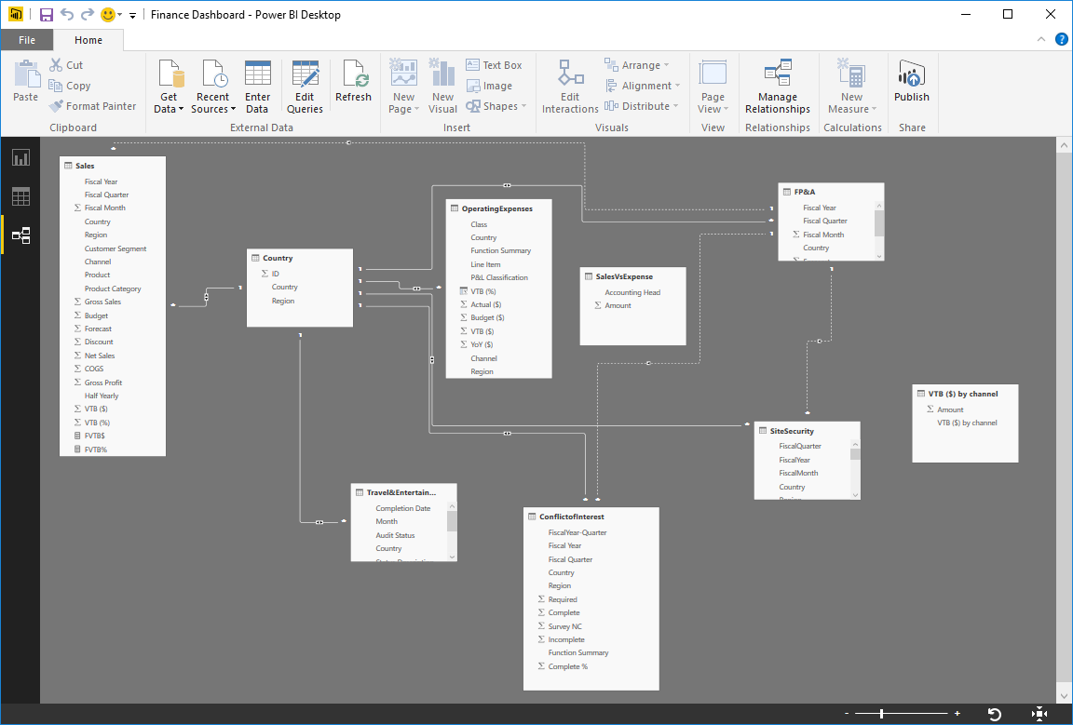
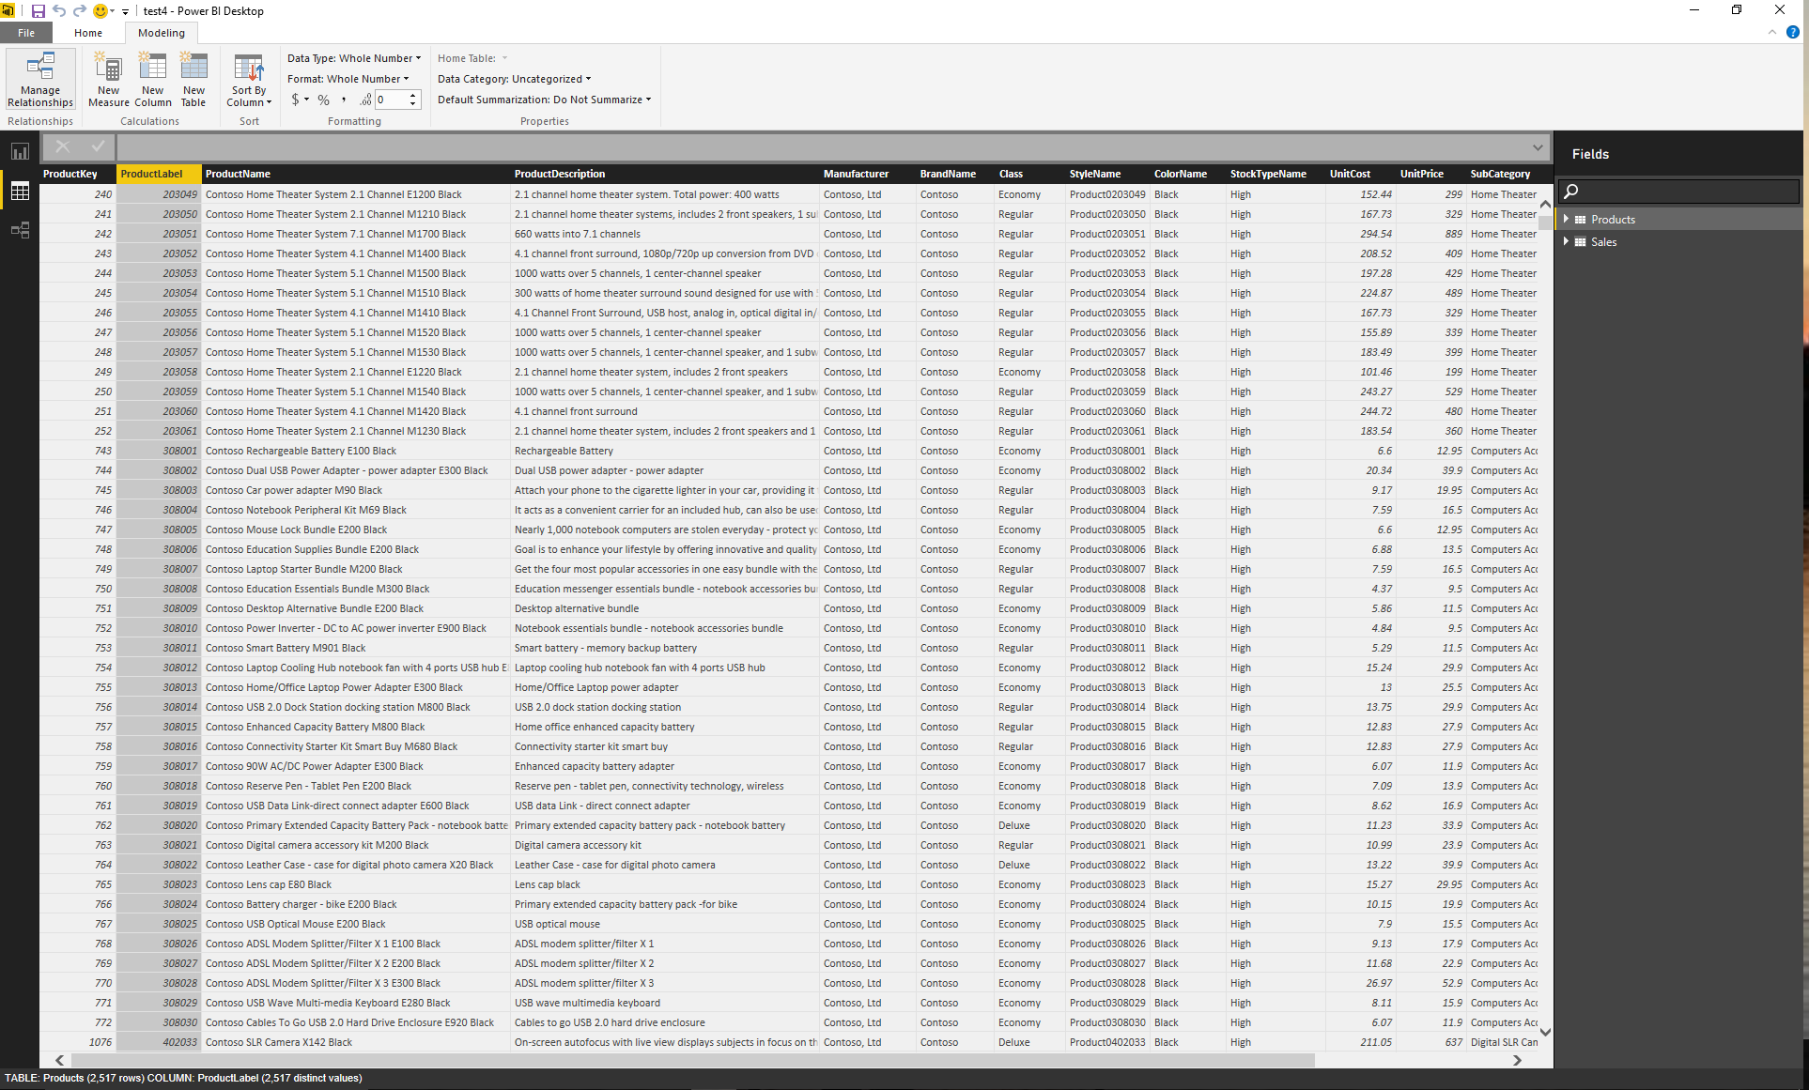
Produce rich data models using formulas and relationships
Power BI Desktop
Automatically create a model by importing data
Relationships are detected automatically, data is categorized and default summarization applied
Create relationships via drag & drop between tables
Refine models to enable complex calculations
Use automatically generated measures, create custom measures, or create Calculated Tables with Data Analysis Expressions (DAX) formulas
High-performance, in-memory engine
Secure your data at the row level by defining security filters for Roles or in the model
Prepare
Explore
Report
Share &
collaborate
DAX Function Reference
Notes:
Power BI Desktop enables extensive data analysis, enabling you to produce rich data models using formulas and relationships
Automatically create a model simply by importing data
Power BI Desktop detects relationships automatically, categorizes data and applies default summarization
Refine models to enable complex calculations
Identify relationships between datasets from a variety of sources
Create relationships between tables manually or using the AutoDetect feature
Desktop’s AutoDetect feature accelerates your analysis
Adjust relationship type (one-to-one, many-to-many or many-to-one) and cross-filter data for specific insights
Define calculations – known as measures – to generate new fields for use in reports. Measures create new information from existing data already in your model
Measures are used in some of the most common data analysis; for example, sums, averages, minimum or maximum values, counts, or more advanced calculations you create yourself using a DAX formula.
The calculated results of measures are always changing in response to your interaction with your reports, allowing for fast and dynamic ad-hoc data exploration
You can use automatically generated measures, or create custom measures with Data Analysis Expressions (DAX) formulas
This helps you enrich your data model
Produce exactly the results you need using the DAX library of 200+ formula elements
Use DAX library to create calculated tables too…
Develop advanced analytics using a combination of measures and relationships
Uncover correlations, highlight exceptions and understand business outcomes
Define synonyms for improved Q&A experience in Power BI service
Power BI row-level security allows you to secure your data at the row level by defining security filters for Roles or in a table in the model. You can define a Role and an associated security filter in the Power BI desktop and then assign members to that Role in the service. Once you have defined security filters for roles, you can test them in action by viewing the data as a specific Role in either the Power BI Desktop or the Power BI Service.

Slide 36
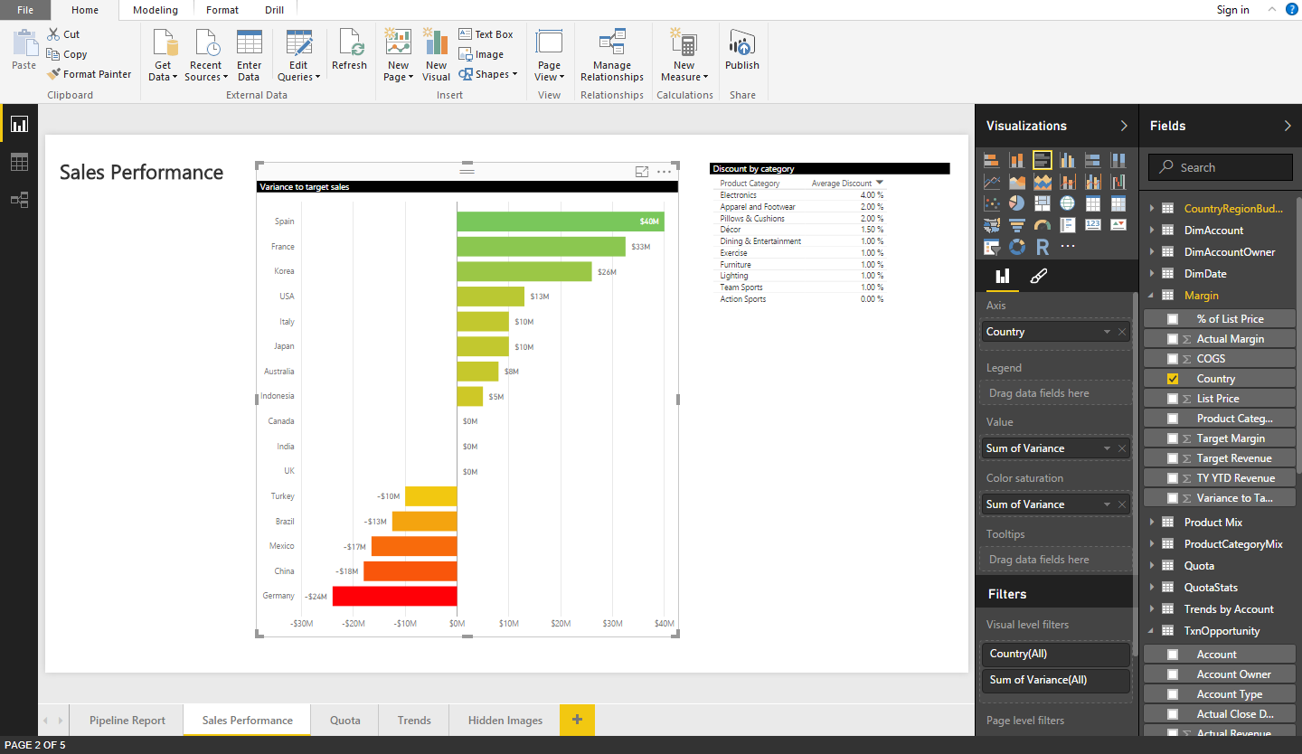
Power BI Desktop
Explore your data with freeform, drag and drop canvas
Explore data in a variety of ways and across multiple visualizations
Pivot and slice data
Drill into and across datasets
Date sort and filters including Min, Max functions
Quick Calc functions
Change visualization types
Select, transform and mashup data via freeform, drag-and-drop canvas
Filter data and use cross-filters
Run R scripts and import the resulting datasets into a Power BI Desktop data model
Prepare
Explore
Report
Share &
collaborate
Notes:
The reporting step is where the visual data exploration enabled by Power BI Desktop really comes to life
Note: you can move directly from connecting to (importing) data to reporting – data preparation, modeling, and analysis are optional intermediate steps. Because Power BI Desktop automatically creates a data model for you upon data import, you can immediate generate reports
Explore data in a variety of ways and across multiple visualizations
Select data elements and sort data
Filter data and use cross-filter capabilities
Drill into and across datasets
Pivot and slice data
Power BI Desktop enables you to visualize data in a number of ways and easily author reports
Depict data in compelling reports that tell stories using a range of interactive visualization
Use data from different sources in a single, consolidated report – create relationships between different data sources to create a data model, that you can then use in a report
You can select, transform and mashup data via a freeform, drag-and-drop canvas
Explore data in a variety of ways and across multiple visualizations
Select data elements and sort data
Filter data, leveraging cross-filter capability
Drill into and across datasets
Pivot and slice data
Change visualization types
Use Quick Calc functions, e.g. to calculate and show the percent of the grand total for each data value.

Slide 37
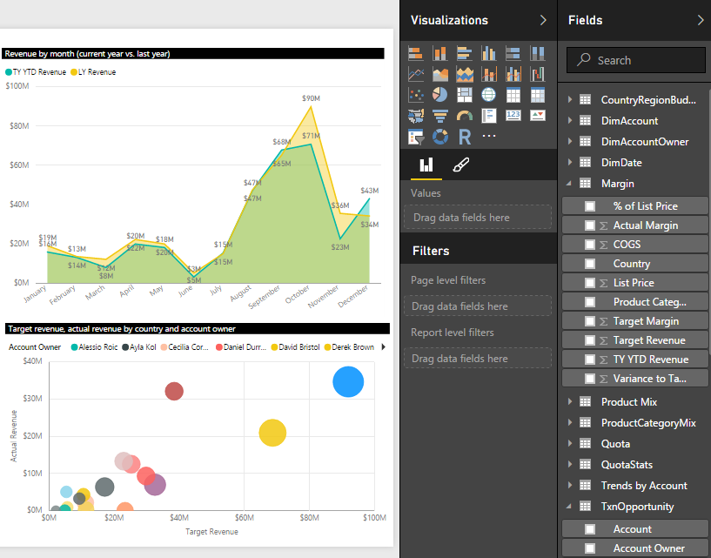
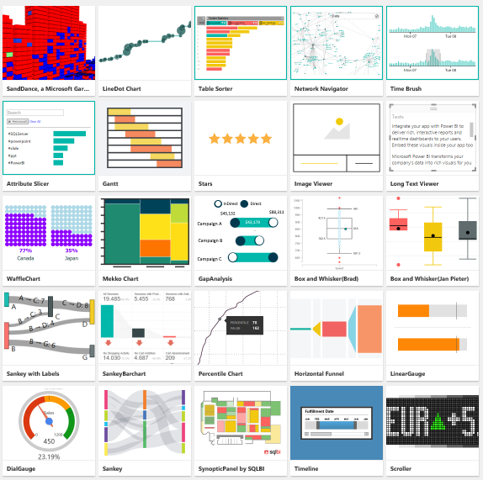
Deliver valuable insights with customizable visual reports
Power BI Desktop
Depict data in compelling reports that tell stories using a range of interactive visualizations
Use data from many sources in a single, consolidated report
Create compelling visuals by integrating with R
Ability to incorporate custom visualizations
Build reports with KPI trends
Change color, format and customize visualizations
Linear or Logarithmic scales in Y-axis
Customizable tooltips
Prepare
Explore
Report
Share &
collaborate
Notes:
The reporting step is where the visual data exploration enabled by Power BI Desktop really comes to life
Note: you can move directly from connecting to (importing) data to reporting – data preparation, modeling, and analysis are optional intermediate steps. Because Power BI Desktop automatically creates a data model for you upon data import, you can immediate generate reports
Power BI Desktop enables you to visualize data in a number of ways and easily author reports
Depict data in compelling reports that tell stories using a range of interactive visualization
Use data from different sources in a single, consolidated report – create relationships between different data sources to create a data model, that you can then use in a report
You can select, transform and mashup data via a freeform, drag-and-drop canvas
Explore data in a variety of ways and across multiple visualizations
Select data elements and sort data
Filter data, leveraging cross-filter capability
Drill into and across datasets
Pivot and slice data
Change visualization types
Show trend lines
Display record set for visualization
Tables: Use conditional table formatting and built-in table styles
Maps: Shape Map visual supports use of custom maps (TopoJSON format)
Customize tooltips – add more context and detail for the end user

Slide 38
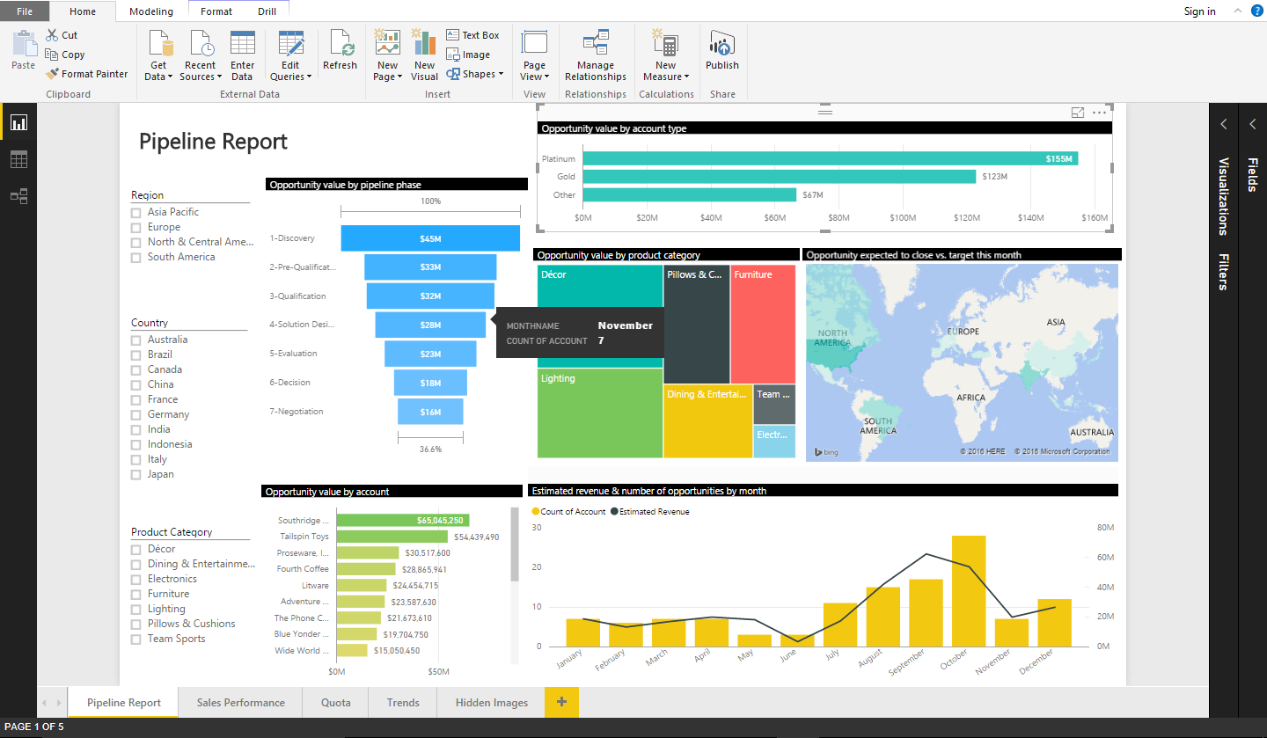
Power BI Desktop
Share reports, visualizations and data with a broad audience
Save Power BI Desktop report files and easily publish them to Power BI
Share as appropriate with other Power BI users in your organization
Copy table, cells or columns to clipboard
Use Power BI template (.pbit file) to save and share the definition of a Report, Data Model and queries, not actual data
Prepare
Explore
Report
Share &
collaborate
Notes:
Once you are ready to publish your report and the visualizations within it, you can surface it to a broader audience by publishing to the Power BI service
Save the Power BI Desktop file, then go into the Get Data interface on powerbi.com to upload the report and share it with others
This enables you to give Power BI users access to richer data models and reports than they could create on their own
If you’re not ready to move your PBIX reports and data to the cloud, but you want to share analytics content across the enterprise, giving Power BI Desktop users the ability to publish PBIX files to an on-premise or private cloud server, you can use the “Publish to Pyramid Server” functionality.

Slide 39
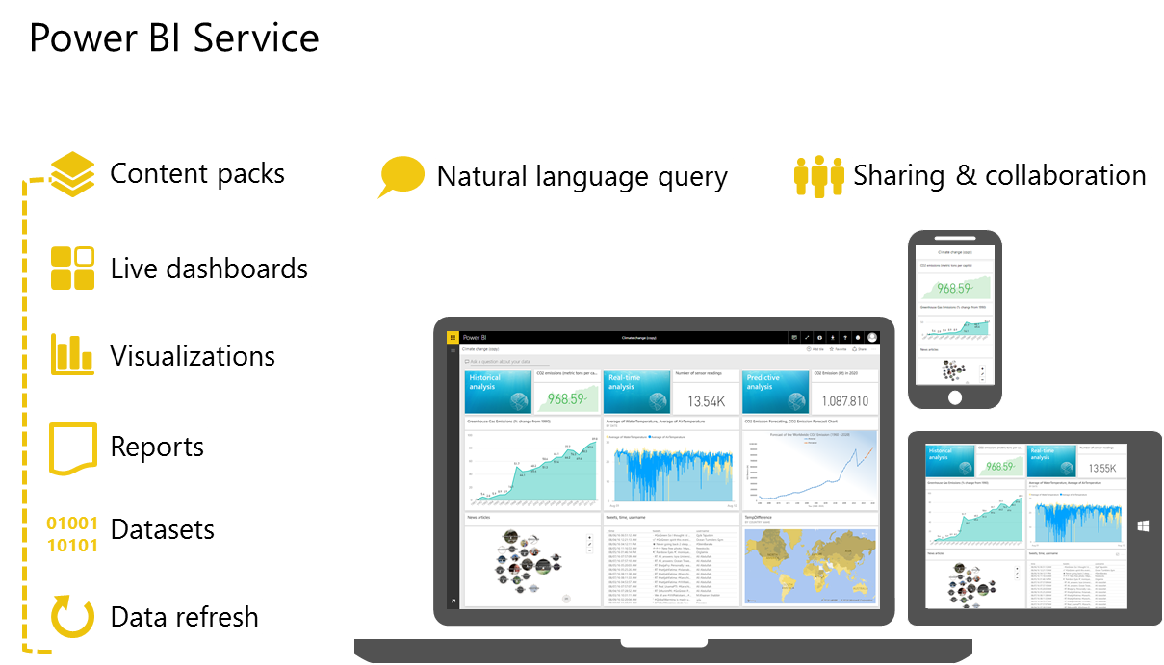
Power BI Platform
Develop exactly what your organization needs
</>
embed
extend
integrate
Visuals
Create your own custom visuals for Power BI
Integration
Integrate Power BI into existing applications
Push data
Push data directly from an application into Power BI
Real-time
Enable real-time content management and monitoring so users can uncover the latest insights from device, sensor and application data
Notes:
Key message:
Power BI provides developers with a platform to embed, extend and integrate Power BI into other applications.
Talking points:
Embed
Power BI reports and tiles can be embedded into existing applications.
Extend
You can create a custom visual using the Power BI Developer Tools (Preview). In the Power BI Developer Tools, design and test a custom visual by writing custom visual TypeScript code, and creating CSS. Once you've tested your custom visual, you can export it to Power BI, or submit it to the Power BI visuals gallery.
Integrate
Here are some of the important uses of APIs:
Push data directly from another application into Power BI.
Push not only static data, but also real-time data, into Power BI.
Just as Azure Stream Analytics can push data directly into Power BI, you can enable other applications to do the same thing for real time visibility.
This enables users to manage and monitor real-time content.
As discussed earlier, you can create custom connectors and content packs for unique data sources that Power BI doesn’t support as a default.
Manage authentication using Azure Active Directory integration.
Resources
http://dev.powerbi.com
http://azure.com/powerbiembedded
http://blogs.msdn.com/powerbidev
http://visuals.powerbi.com

Slide 40
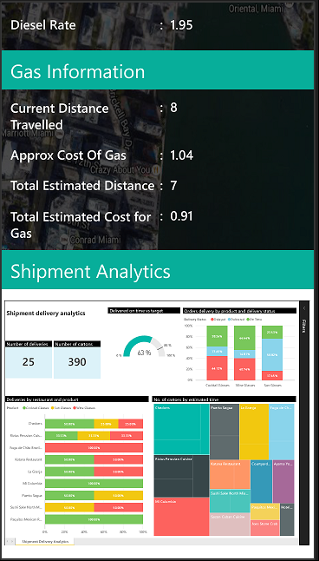
Power BI Embedded
Embedding Power BI in your application
</>
Application developers can embed Power BI tiles and reports as an IFrame into an app, such as a mobile app or web app.
Provides users customizable data tiles or reports in an app for a small investment.
Users can integrate data from any data source outside the application to enhance contextual understanding.
Users can click an embedded Power BI tile or report to navigate to the Power BI dashboard.
embed
AAD User
Anonymous
Notes:
Key message:
Power BI reports and tiles can be embedded into existing applications.
Talking points:
With Power BI, you can enable application developers to integrate Power BI tiles and reports from a user's power BI account by embedding an IFrame into an app, such as a mobile app or web app. The PowerBI.com service allows business users to build, and personalize charts, reports, and dashboards in their own Power BI account. The embed a tile or report capability enables you to integrate those tiles or reports into an app.
Some of the benefits of integrating Power BI tiles or reports into an app:
Provide users customizable data tiles or reports in an app for a small investment.
Users can integrate data from any data source outside the application to enhance contextual understanding.
Users can click an embedded Power BI tile or report to navigate to the Power BI dashboard.
Power BI Embedded SDK for Node JS available

Slide 41
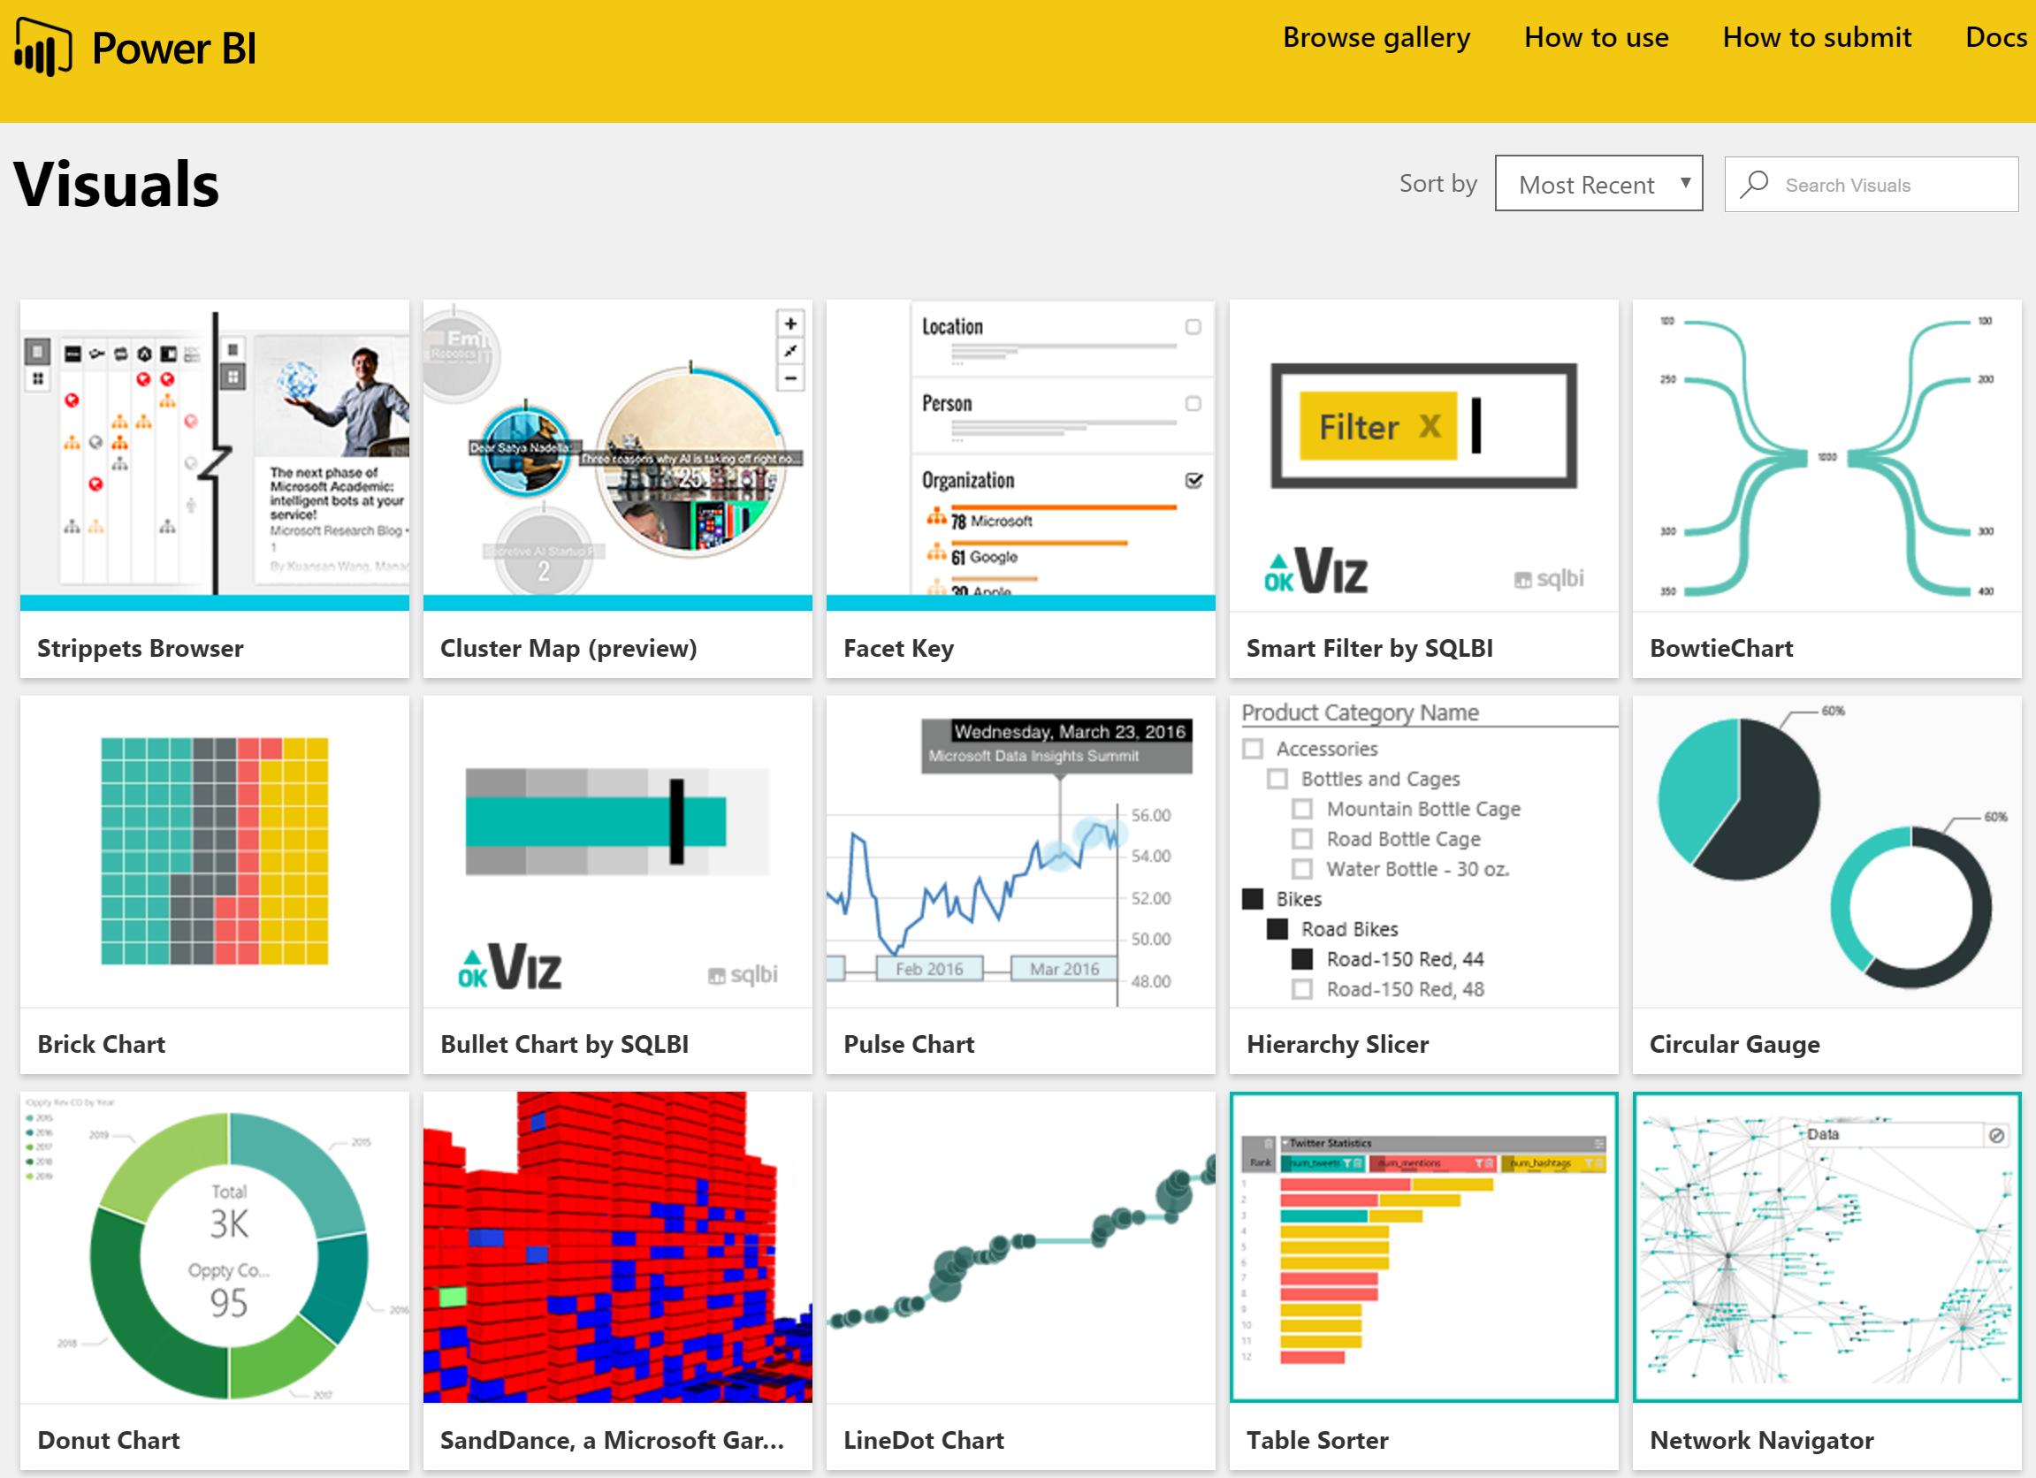
Power BI Custom Visuals
Custom Visuals
</>
Browse the Power BI Visuals Gallery (visuals.powerbi.com) for community created visuals that you can download
New visuals being added continuously
Upload a new visual in Report View to start using it
Create your own custom visuals from the published open source visuals and the provided framework
Submit your custom visuals to the community
extend
AAD User
Anonymous
Notes:
Key message:
Power BI has a Visuals Gallery with community created custom visuals.
Talking points:
You can browse through the visuals or submit one of your own for others to use.
1. Create a custom visual with the Power BI Developer Tools (Preview)
https://powerbi.microsoft.com/en-us/documentation/powerbi-custom-visuals-getting-started-with-developer-tools/
2. Submit your custom visual to the Power BI visuals gallery

Slide 42
Power BI REST APIs
Open APIs for integration
</>
Programmatically access Power BI resources (datasets, tables, schemas)
Use the REST API to push data directly from your application into Power BI
Uncover real-time insights from devices, sensors and applications
Import Desktop files programmatically
Azure Active Directory and OAuth 2.0 for user authentication
Power BI SaaS Service
integrate
Power BI User Account
AAD User
Datasets
Reports
Dashboards
Your Service or Application
Push Data Component
Push Content Component
Anonymous
Notes:
Key message:
Power BI REST APIs allow developers to push data into a dashboard.
Talking points:
Here are some of the important uses of APIs:
Push data directly from another application into Power BI.
Push not only static data, but also real-time data, into Power BI.
Just as Azure Stream Analytics can push data directly into Power BI, you can enable other applications to do the same thing for real time visibility.
This enables users to manage and monitor real-time content.
You can add Power BI to existing application workflows.
As discussed earlier, you can create custom connectors and content packs for unique data sources that Power BI doesn’t support as a default.
Manage authentication using Azure Active Directory integration.
Data APIs:
List and create datasets (GET, POST)
List the tables in a dataset (GET)
Update schema of a table (PUT)
Add and clear rows in a table (POST, DELETE)
Modeling properties, including measures or relationships available through API
Data API limits:
1M rows per hour (paid) / 10K rows per hour (free)
Import APIs:
List all imports or import new file (GET, POST)
Get status of an import (GET)
Set credentials (PATCH)
Update connection information (POST)

Slide 43
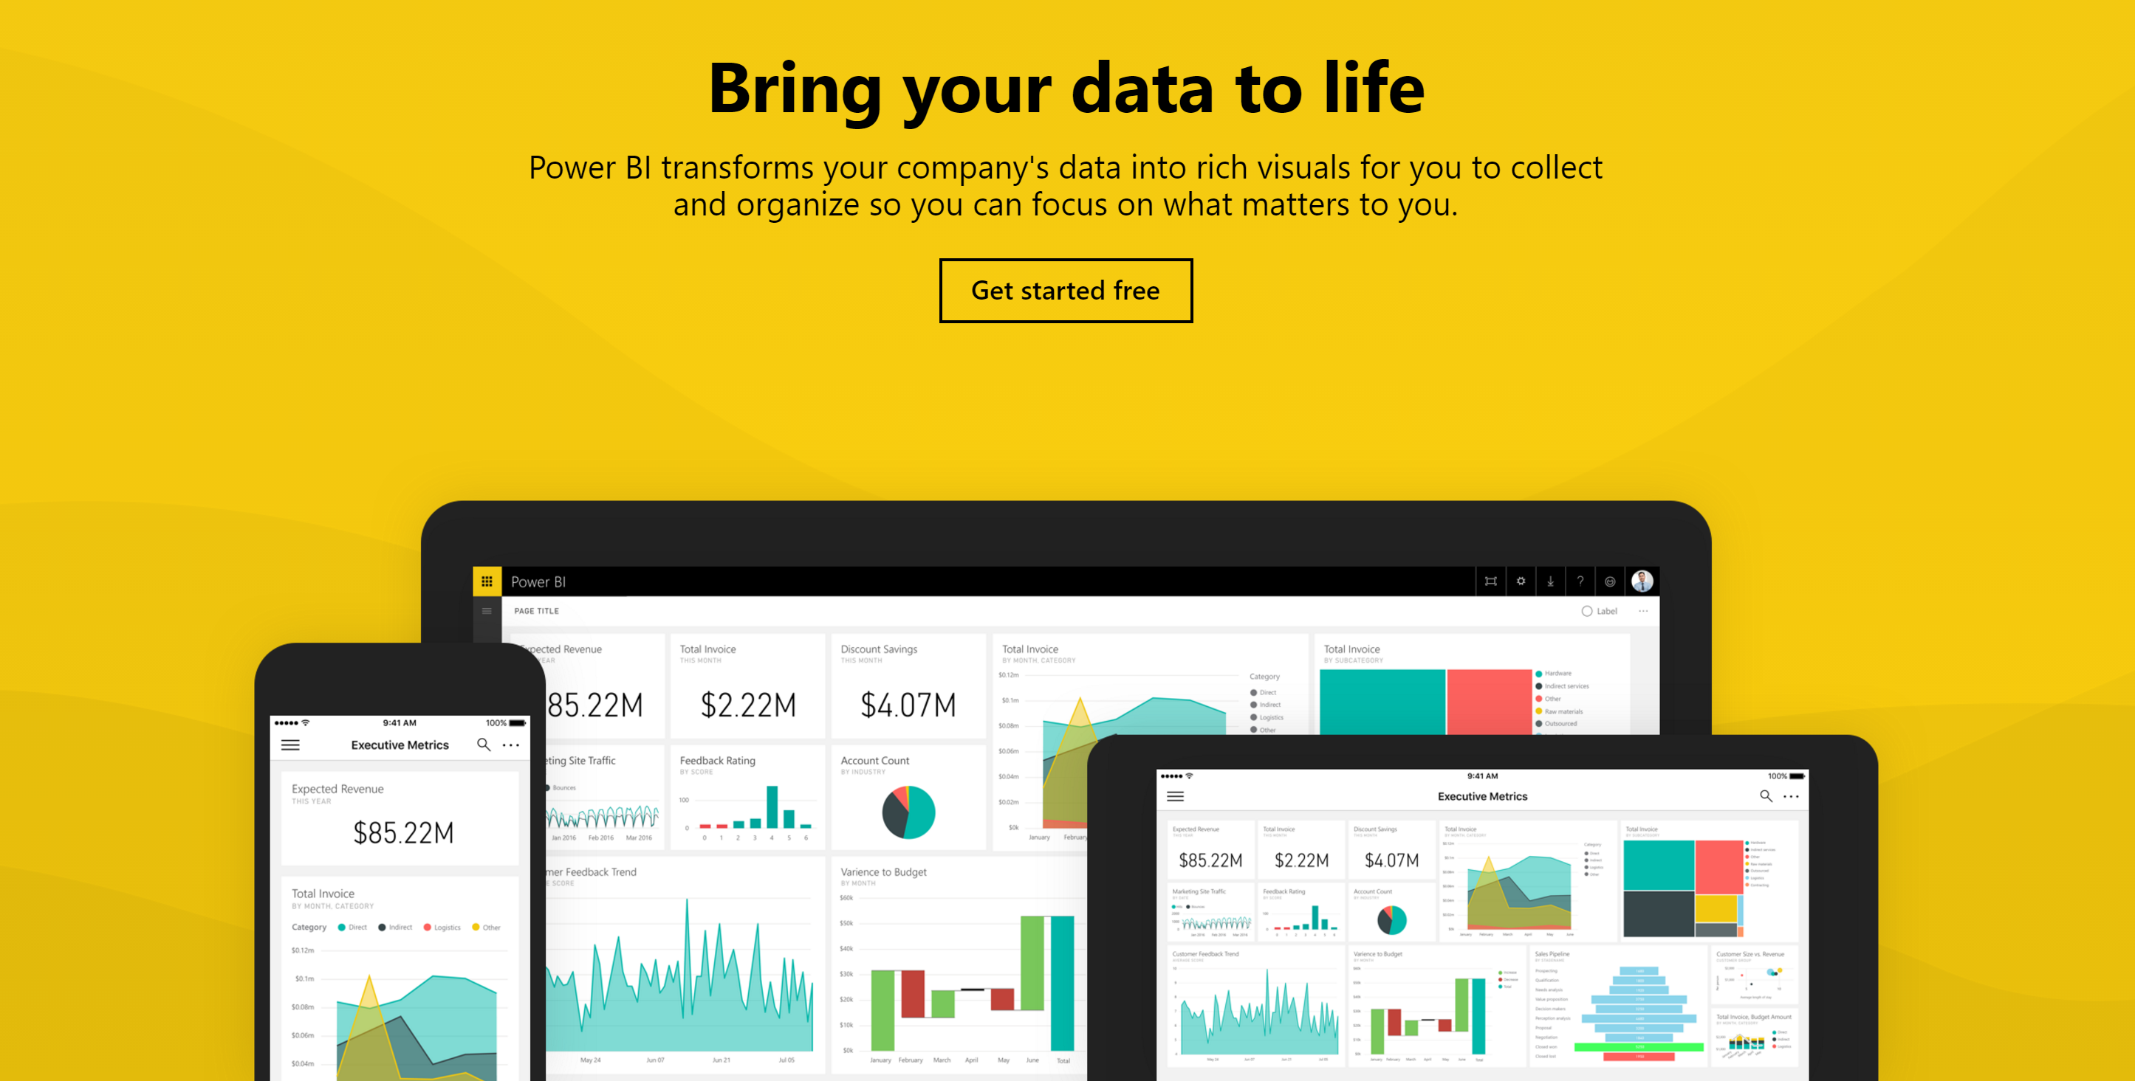
Get started today at powerbi.com
Notes:
Thanks for taking the time to walk through the main capabilities of Power BI.
If you’re ready to start exploring what Power BI can do for you and your organization, please visit powerbi.com.

Slide 45
V 4.0 Updates
SaaS content packs:
NEW: Project “Madeira”, Microsoft Dynamics AX, Prevedere, Xero,
NEW: Solution templates: Dynamics CRM, Salesforce
Dashboards:
Improved multi-user account experience
Vimeo video tile
Quick insights, scoped insights
Favorite dashboards
Notification center
Data driven alerts
R visuals
Data classification (HBI, LBI,…)
Visualizations:
New custom visuals – Narratives for Power BI, LineDot Chart, Time Brush, Table Sorter, Network Navigator, Attribute Slicer, Pulse Chart, Strippets Browser, Cluster Map, Facet Key
Q&A:
Q&A for enterprise gateway connected data sources – starting with support for SQL Server 2016 Analysis Services tabular models
Reports:
Upload complete Excel workbook
Analyze in Excel, with support for RLS
R visuals
Data
Analyze in Excel, with support for RLS
“Get Data” experience for Enterprise Gateway connected Analysis Services models
Increased file size limit of 1 GB for both Excel workbooks and Power BI Desktop files.
Connectivity:
SAP BW Server, scheduled refresh via Gateway
Azure ExpressRoute
RLS for direct query data sources

Slide 46
V 4.0 Updates – contd.
Gateway:
Enterprise Gateway connected Analysis Services models directly from within the Power BI “Get Data” experience
Support for refreshing datasets and reports connected to SAP Business Warehouse Server
UPN Mapping - enables gateway admins to apply custom security rules by mapping users’ cloud identity to specific on-prem roles or identities
New data sources: IBM DB2 (improved), Informix
Enterprise Gateway now On-premises Data Gateway, supporting Power BI, PowerApps, Microsoft Flow, Azure Logic Apps
Personal Gateway will continue as is and can only be used with Power BI.
Administration/Enterprise:
Row level security, support for content packs
RLS for direct query data sources
AAD groups for RLS
Azure ExpressRoute
Power BI added to Microsoft Trust Center
UPN Mapping - enables gateway admins to apply custom security rules by mapping users’ cloud identity to specific on-prem roles or identities
Developers:
Power BI Embedded SDK for Node JS
Power BI Embedded available worldwide
Publish to web (GA)
Dataset API: Additional modeling properties, sequence numbers
New custom visual developer tools

Slide 47
V 4.0 Updates – contd.
Mobility – all platforms
Multi-select for report slicers
Global search and recent items
Power BI notification center
SQL Server 2016 Reporting Services
Mobility - platform-specific
Windows app
Presentation mode (full screen)
Live tiles – pin KPI, card, or multi-row card directly to Start screen
SQL Server 2016 Reporting Services
Drill through from KPI to report
iOS app
SQL Server 2016 Reporting Services
Shared datasets
Custom themes
Generate and scan QR codes for reports
QR with augmented reality mode
Favorite dashboards
Barcode scanner
Geographic filtering
Android app
SQL Server 2016 Reporting Services
NTLM auth
Shared datasets
Custom themes

Slide 48
V 3.0 Updates
SaaS content packs:
NEW: Visual Studio, Projectplace, Project Online, Vmob, Bing, O365Mon, Smartsheet, AT Internet, Lithium, Azure Search, Troux, Zuora, Insightly, Alpine Metrics, Dynamics AX, Azure Security Center, Windows Dev Center, ClickDimensions, IntelliBoard, Ziosk, “Madeira”
Improved: Google Analytics
Organizational content packs:
Include Excel workbook
Update with report only changes
Q&A:
Trend lines for correlations and trends
Gauge and area charts in Q&A
Improved auto-complete
Reports:
Duplicate report page
Improved load time
Chromeless full-screen mode
Print report page
Export report visual data
Connectivity:
DirectQuery for SAP HANA
DirectQuery for Analysis Services tabular and multidimensional
Connect to Files on SharePoint Team Sites
Couchbase Server v4
SAP BW Server
Azure ExpressRoute
Visualizations:
Show KPIs and images from URLs in tables, matrices and cards
New custom visuals – Timeline Slicer, Word Cloud, Force-Directed Graph, Globe Map, Scroller, Synoptic Panel, Sankey diagram, Gauges, Horizontal Funnel, Percentile Chart, Sankey Bar Chart, Box-and-Whisker Plots, Gap Analysis, Mekko Chart, Waffle Chart, Gantt Chart, SandDance,
Change interactions between report visuals
Use images in slicers
Gateway:
New features in Personal Gateway…..
GA of Enterprise Gateway
Live connection for Oracle and Teradata
Scheduled Refresh for all previously supported data sources except Analysis Services and Blank Query based reports. This includes: SQL Server, Teradata, Oracle, DB2, MySQL, Sybase, SAP HANA, OData, Web, Files and Folders on-premises, and SharePoint list on-premises
Cortana:
Integration of Power BI with Cortana.

Slide 49
V 3.0 Updates – contd.
Dashboards:
Improved, chromeless full-screen mode
Freely position tiles on dashboard
Duplicate dashboards
Pin a range from Excel to dashboard
Improved load time
Know where our data is stored (data center)
Create QR codes for a tile
Refresh dashboard tiles, with time setting
Pin entire report page
Export tile data
Add widgets for: image, text box, video, web content
Print a dashboard
Fit to width full-screen mode
Tooltips on tiles
Publish from Excel
Analyze data in Excel
R tiles
Zoom
Quick insights when you publish Power BI Desktop files
Featured dashboard
Filter dashboard list
Sharing & collaboration:
Invite colleagues who aren’t in Azure AD to Power BI groups
Share dashboard directly to another user’s workspace
Shared dashboard notification
Contact Owner of a Shared or Organizational Dashboard
Share with users outside your organization
Request access to a dashboard
Subscriptions:
Individuals can buy Power BI
Guided purchase experience
Easier to close account
Power BI Pro is available as part of the new Office 365 E5 plan or as a stand-alone offering
Administration/Enterprise:
Monitor health of Power BI service in O365 Admin Portal
Easy user management with a link to the O365 Admin Center
Disable publish to web, export data
Prevent users from publishing content packs to the entire org
Disable sharing content to external users
Admin usage reporting
Row level security, support for content packs
Development:
Integrate (embed) reports into applications
Filtering on embedded reports via URL parameters
API to list all reports in a workspace
Easier to register app for Power BI
Publish to web
International:
Localized documentation content
Power BI in Brazil, Australia
Hebrew and Arabic support
Language settings

Slide 50
V 3.0 Updates – contd.
Mobility – all platforms
Visualizations
R tiles
Landscape mode
Open and interact with reports
Improved scatter chart animation
Access reports from Report Gallery
Device Management
Intune support
Data
Cached data does not expire
Refresh in real-time
Offline indicator and capabilities
Mobility - platform-specific
Windows app
Direct links for dashboard tiles
Power BI Windows 10 Universal App for desktops, tablets, and smartphones
View reports
Recent items and global search
Pin KPI, or card tile directly to phone Start screen
Presentation mode (full screen)
iOS app
Picture tiles
New dashboard actions menu
Scan QR codes
Access SQL Server 2016 mobile reports and KPIs
View pinned report pages
Share notifications
View reports
Power BI for Apple Watch
Recent items and global search
Android app
Scan QR codes
View pinned report pages
Support for Intel Chipsets, allowing phones such as Zenfone5 to install and enjoy the Power BI app for Android.
Expanded support for Android 6.0 Marshmallow OS, including the ability to toggle application access for camera, contacts, and voice.
Access SQL Server 2016 mobile reports and KPIs

Slide 51
V 2.0 Updates
SaaS content packs:
NEW: SQL Sentry, Circuit ID, Mandrill, Azure Mobile Engagement, Adobe Analytics, Webtrends, tyGraph, comScore, Mandrill
Sample industry related / departmental content packs:
NEW: Spend Analysis, Quality Analysis, Customer Profitability, Human Resources, Opportunity Analysis, Procurement Analysis, Sales and Marketing
Q&A:
By default, you will see a list of suggested questions for tiles on your dashboard or tables in your dataset
Suggestions will include specific terms from the data (e.g. column names or row values)
Add your own featured questions, e.g. frequently asked questions to your dataset
Data sets:
Increased limit of up to 200 datasets per Power BI account
Reports:
Increased limit of up to 200 reports for each dataset per Power BI account
View modes: Dynamic (optimized for browser window), Fit to Page, Fit to Width, Actual Size
Drill down support
Friendly hyperlinks in text items
Enhanced canvas experience (also see Power BI Desktop updates)
Page size can be configured: Dynamic, 4:3, 16:9, Letter and Custom (width/height in pixels)
Full screen pop out mode for report visuals
Reports (contd.):
Insert shapes: rectangle, oval, line, triangle and arrow. Format shape with line/fill colors, rotation, title, background.
Visualizations:
Scatter chart bubbles can be filled/empty
Images – aspect can be locked to avoid image distortion during resizing
Custom visuals - in Power BI service and Desktop. Upload and incorporate custom visuals into your reports. Visuals gallery at visuals.powerbi.com. Developer tools to develop, test and package new custom visuals.
Dashboards:
Display modes: Full Screen, Fit to Screen
In-focus (full screen) mode for tiles
Last update time and source information shown on tile in in-focus mode
Choose which dashboard to pin your visual to – existing or create a new one
Pin a tile from one dashboard to another
Control the visual colors in the dashboard. Dashboard theme can be different from report theme to achieve consistency across visuals
More resize options for your tiles: choose from size 1x1 up to 5x5 tile units

Slide 52
V 2.0 Updates – contd.
Sharing & collaboration:
Share (and un-share) a dashboard from your group space the same way you would from your own space
Sharing invite can be sent to alternate email address (in addition to original email address), if configured in O365 account profile
Share without email notification, copy and share a link instead, e.g. on another portal
Read-only membership in groups
Share dashboards with Active Directory Security Groups (Role Based Access Control)
People picker with autocomplete as you start typing the name of recipients
Copy/paste large number of email addresses you want to share with, e.g. copy directly from Outlook
Collapse navigation pane with URL parameter
Subscription
Free vs. Pro: Power BI Pro is available for 60 day trial period. An extension can be requested
Power BI will be available to all customers on the Dedicated on Multitenant (DonMT) O365 architecture
Mobility – all platforms
Login
Improved login and authentication to help users understand and troubleshoot login issues
Improved performance of sign in process
If you are new to Power BI, activate your user account directly from your mobile device
Visualizations
Improved data formatting of charts, including line charts
Improved the scroll and touch gestures of the matrix tile. Easily scroll down your matrix tile and get all the data natively and mobile optimized
Optimized display for % based line charts
Data labels for line, column and bar charts
Security
Clearer messaging to guide you through the first time experience of working with row level security dashboards
Content packs
Better support for content for dashboard tiles that have a dependency on time zones (e.g. Google Analytics)
Collaboration
Access all your group workspaces content directly from you mobile device

Slide 53
V 2.0 Updates – contd.
Mobility - platform-specific
Windows app
Touch-optimized navigation between tiles. Explore tiles sequentially without the need to return back to the dashboard
View and explore native Excel workbooks (XLSX and XLSM) directly
Support for SSO
iOS app
View and explore native Excel workbooks (XLSX and XLSM) directly
iOS7 no longer supported in favor of the upcoming iOS 9 update
iPhone 5 and above supported
Improved navigation to a more modern slick drawer leaving the main stage for your data
Receive a notification each time a dashboard is added to one of your groups
Android app
Improved navigation from tabs to drawer to optimize the experience and maximize available screen real-estate
Use favorites, share snapshots and annotate directly from your dashboard
Use the links behind the tiles to navigate directly from your mobile tiles to a specific URL or to another dashboard without leaving the app

